Slide 1
MODULE II

Slide 2
Signal Encoding Techniques

Slide 3
Signal Encoding Techniques
Both analog and digital information can be encoded as either analog and digital signals.
Encoding scheme depend on the specific requirements to be met and the media and communication facilities available.
The process is depicted below:

Slide 4
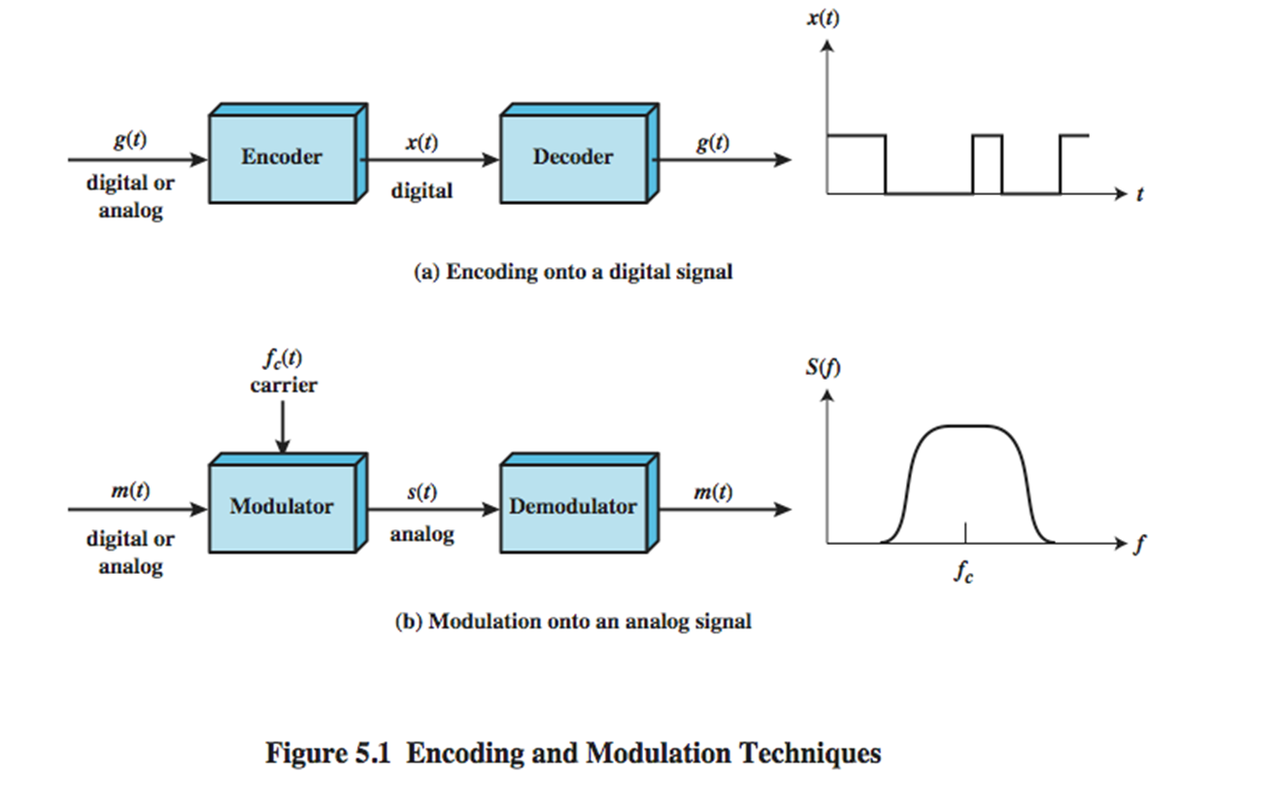
Signal Encoding Techniques

Slide 5
Signal Encoding Techniques
Digital Signaling
For digital signaling, a data source g(t),which may be either digital or analog is encoded into a digital signal x(t).
The actual form of x(t) depends on the encoding technique and is chosen to optimize use of the transmission medium.
For e.g. encoding may be chosen to conserve the bandwidth or to minimize errors.

Slide 6
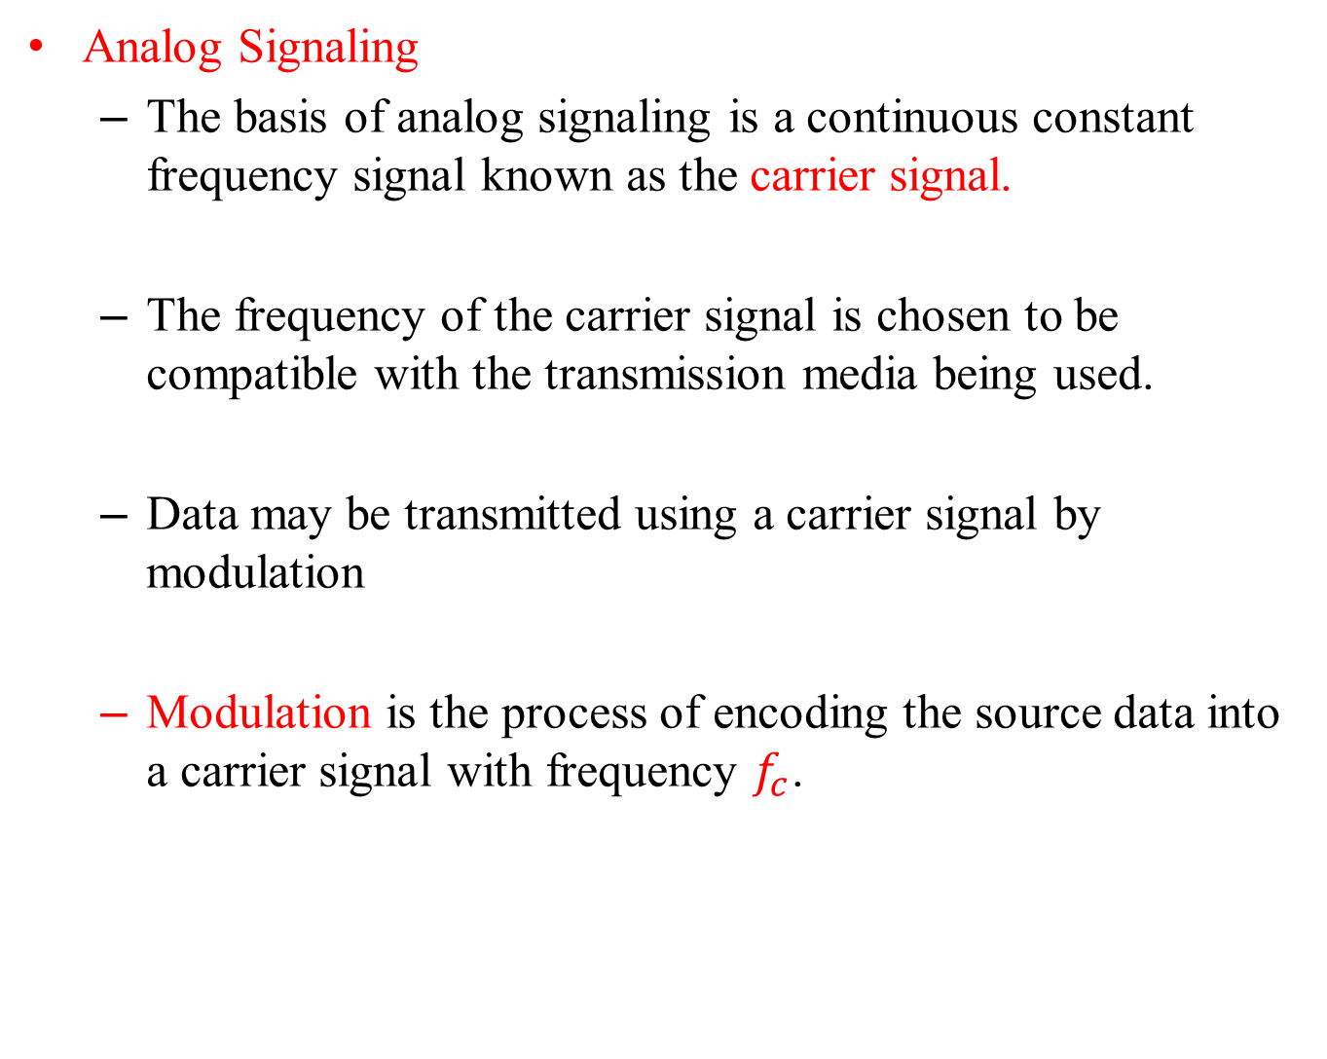
Signal Encoding Techniques
Analog Signaling
The basis of analog signaling is a continuous constant frequency signal known as the carrier signal.
The frequency of the carrier signal is chosen to be compatible with the transmission media being used.
Data may be transmitted using a carrier signal by modulation
Modulation is the process of encoding the source data into a carrier signal with frequency $f_{c}$.

Slide 7
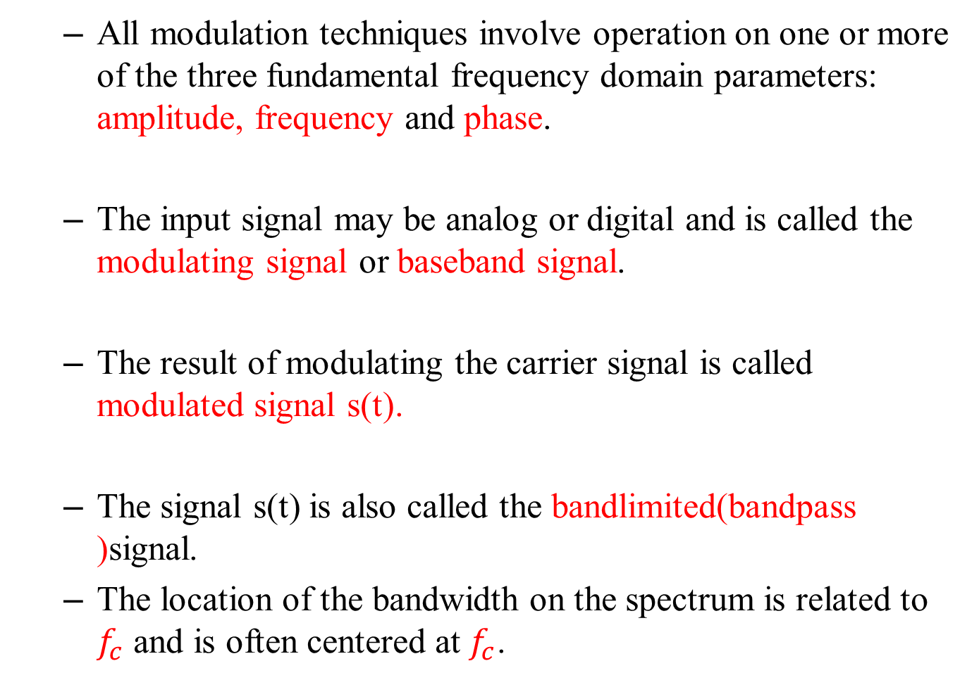
Signal Encoding Techniques
All modulation techniques involve operation on one or more of the three fundamental frequency domain parameters: amplitude, frequency and phase.
The input signal may be analog or digital and is called the modulating signal or baseband signal.
The result of modulating the carrier signal is called modulated signal s(t).
The signal s(t) is also called the bandlimited(bandpass )signal.
The location of the bandwidth on the spectrum is related to $f_{c}$ and is often centered at $f_{c}$.

Slide 8
Signal Encoding Techniques
Any of the combinations of transmissions can be chosen according to the requirements.
Reasons for using the combinations are:
Digital data,digital signal
Less expensive
Less complex
Analog data ,digital signal
Permits the use of modern digital transmission and switching equipment.
Digital data,analog signal
Transmission media such as optical fiber and unguided media will only propagate analog signals.
Analog data,analog signal
Analog data is of the electrical form
Can be transmitted as baseband signals easily and cheaply.
Modulation shifts the bandwidth of the baseband signal to another portion of the spectrum.
Thus multiple signals can share the same transmission medium.(frequency division multiplexing)

Slide 9
Digital Data, Digital Signal
Signal Element versus Data Element
In data communication, our goal is to send data elements.
A data element is the smallest entity that can represent a piece of information(bit).
In digital data communications ,a signal element carries data elements.
A signal element is the shortest unit(timewise) of a digital signal.
Data elements are being carried and the signal elements are the carriers.
The ratio r is the number of data elements carried by each signal elements.
Fig. shows various situations with different values of r.

Slide 10
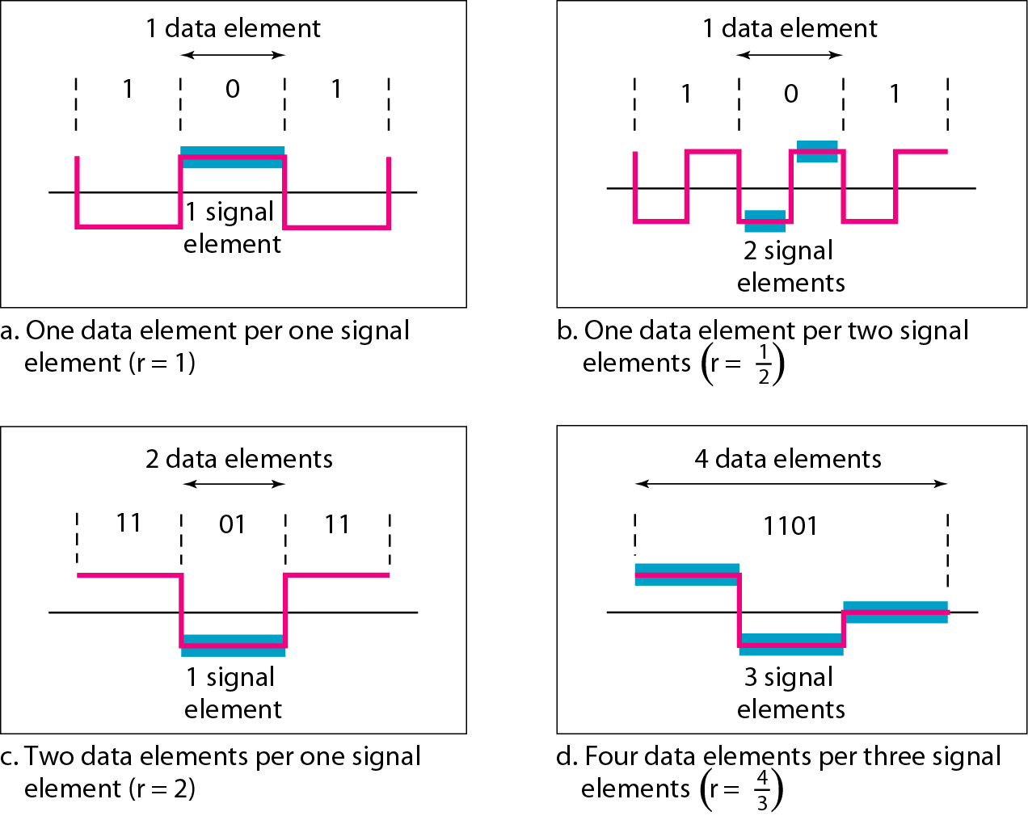
Figure 4.2 Signal element versus data element

Slide 11
Data Rate and Signal Rate
The data rate defines the number of data elements (bits) sent in one second.
The unit of data rate is bits per second(bps).
The data rate is also known as bit rate.
The signal rate is the number of signal elements sent in 1 second.
The unit is baud.
The signal rate is also called pulse rate,modulation rate or baud rate.
Our goal is to increase the data rate while decreasing the signal rate.
Increasing the data rate increases the speed of transmission, decreasing the signal rate decreases the bandwidth requirement.

Slide 12
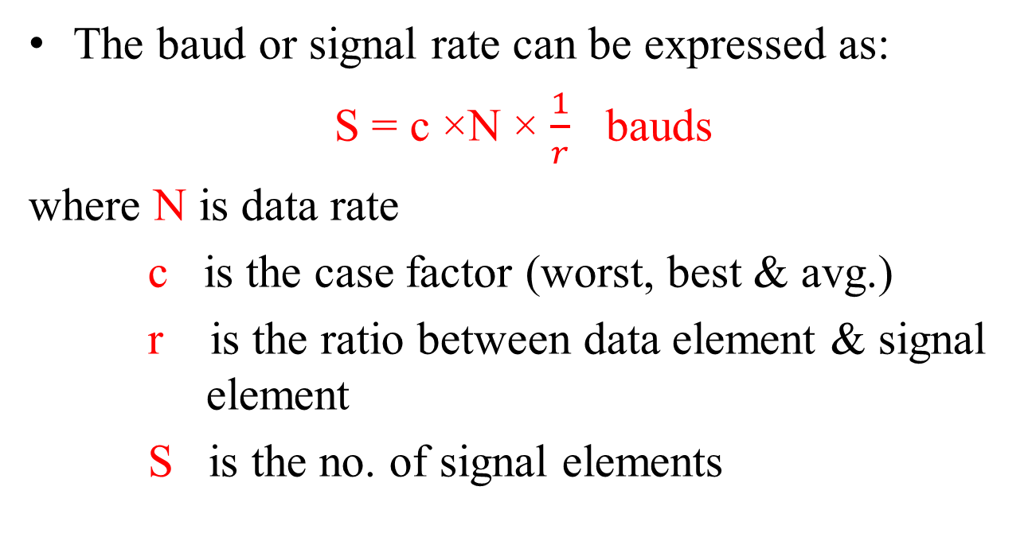
Relationship between data rate and signal rate
The baud or signal rate can be expressed as:
S = c ×N × $\frac{1}{r}$ bauds
where N is data rate
c is the case factor (worst, best & avg.)
r is the ratio between data element & signal element
S is the no. of signal elements

Slide 13
Example 4.1
A signal is carrying data in which one data element is encoded as one signal element ( r = 1). If the bit rate is 100 kbps, what is the average value of the baud rate if c is between 0 and 1?
Solution
We assume that the average value of c is 1/2 . The baud rate is then
S=1/2*100000*(1/1)=50000=50 kbaud

Slide 14
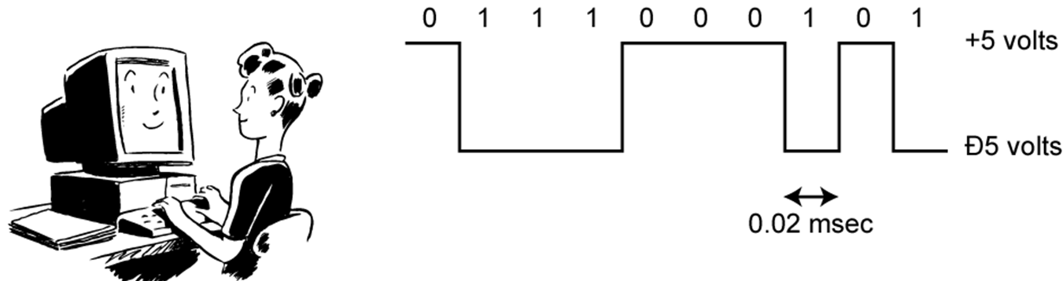
Encoding Digital Data to Digital Signal
A digital signal is a sequence of discrete, discontinuous voltage pulses.
Each pulse is a signal element.
Binary data are transmitted by encoding each data bit into signal elements.
In the simplest case ,there is a one-to-one correspondence between bits and signal elements.
i.e. a binary 1 is represented by a lower voltage level and binary 0 by a higher voltage level.

Slide 15
Interpreting Digital Signals
Receiver needs to know
timing of bits - when a bit starts and when it ends
signal levels i.e. the receiver must determine whether the signal level for each bit position is high(0) or low(1).
Factors affecting signal interpretation
Increase in Signal-to-noise ratio decreases bit error rate
Increase in data rate increases bit error rate
Increase in bandwidth allows increase in data rate
encoding scheme – affects performance
Notes:
The tasks involved in interpreting digital signals at the receiver can be summarized as follows. First, the receiver must know the timing of each bit, knowing with some accuracy when a bit begins and ends. Second, the receiver must determine whether the signal level for each bit position is high (0) or low (1). These tasks can be performed by sampling each bit position in the middle of the interval and comparing the value to a threshold. Because of noise and other impairments, there will be errors. As was shown in Chapter 3, three factors are important: the signal-to-noise ratio, the data rate, and the bandwidth. With other factors held constant, the following statements are true:
• An increase in data rate increases bit error rate (BER).
• An increase in SNR decreases bit error rate.
• An increase in bandwidth allows an increase in data rate.
There is another factor that can be used to improve performance, and that is the encoding scheme. The encoding scheme is simply the mapping from data bits to signal elements. A variety of approaches have been tried. In what follows, we describe some of the more common ones.

Slide 16
Comparison of Encoding Schemes
Signal spectrum
Lack of high frequency components reduces required bandwidth
lack of dc component allows ac coupling via transformer, providing excellent electrical isolation reducing interference
Magnitude of effects of signal distortion and interference depend on the Spectral properties of the transmitted signal.
Good signal design should concentrate the signal power in the middle of the transmission bandwidth
Clocking
Need to determine the beginning and end of each bit position.
Transmitter and receiver can be synchronized by either with an external clock or with a synchronization mechanism based on the transmitted signal

Slide 17
Comparison of Encoding Schemes
Error detection
useful if can be built in to signal encoding which permits errors to be detected more quickly.
Signal interference and noise immunity
some codes are better than others in the presence of noise.
Performance usually expressed in terms of a BER.
Cost and complexity
Higher signal rate (& thus data rate) lead to higher costs
some codes require signaling rate greater than the actual data rate.

Slide 18
Encoding Digital Data to Digital Signal
Line Coding
Converting a string of 1’s and 0’s (digital data) into a sequence of signals that denote the 1’s and 0’s.
For example a high voltage level (+V) could represent a “1” and a low voltage level (0 or -V) could represent a “0”.

Slide 19
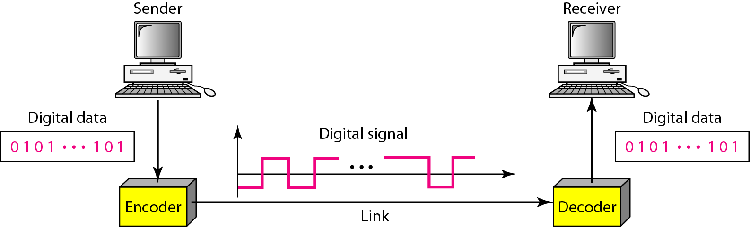
Figure 4.1 Line coding and decoding

Slide 20
Line coding schemes
Classified into three broad categories:
Line Coding
unipolar polar bipolar
-NRZ - RZ -AMI
-NRZ-L,NRZ-I -Pseudo ternary
-Biphase - Scrambling
- Manchester -B8ZS
- Differential -HDB3
Manchester

Slide 21
Line coding schemes
Unipolar
In a unipolar scheme ,all the signal levels are on one side of the time axis, either above or below.
e.g. NRZ(Non-Return-to-Zero) ;

Slide 22
Unipolar Non-return- to- Zero(NRZ)
two different voltages for 0 and 1 bits
voltage constant during bit interval
no transition i.e. no return to zero voltage in the middle of bit time.
absence of voltage for zero, constant positive voltage for one

Slide 23
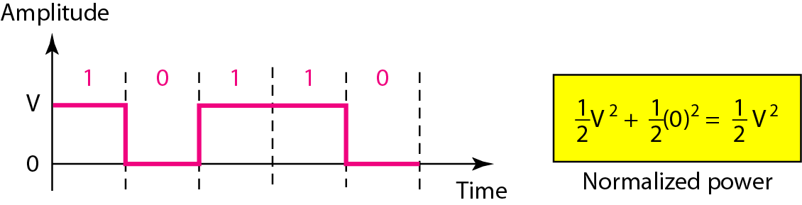
Figure 4.5 Unipolar NRZ scheme

Slide 24
Unipolar Non-return- to- Zero(NRZ
Disadvantage
This scheme is costly
Not used in data communication today since the normalized power (i.e. the power required to send 1 bit per unit line resistance )is double that of polar NRZ .

Slide 25
Line coding schemes
Polar Schemes
The voltages are on both sides of the time axis.
Polar NRZ scheme can be implemented with two voltages. E.g. +V for 0 and -V for 1.
There are two versions:
NRZ - Level (NRZ-L)
NRZ - Inversion (NRZ-I)

Slide 26
Line coding schemes
NRZ - Level (NRZ-L)
Use two different voltage levels for the two binary digits.
positive voltage for one symbol and negative for the other.
Voltage level is constant during a bit interval.
Is used by terminals and other devices .

Slide 27
Line coding schemes
NRZ - Inversion (NRZ-I)
Maintains a constant voltage pulse for the duration of a bit time.
the data themselves are encoded as the presence or absence of a signal transition at the beginning of the bit time.
A transition (low to high or high to low) at the beginning of a bit time denotes a binary 1 for that bit time ;no transition indicates a binary 0.
i.e. the change or lack of change in polarity determines the value of a symbol. E.g. a “1” symbol inverts the polarity a “0” does not.

Slide 28
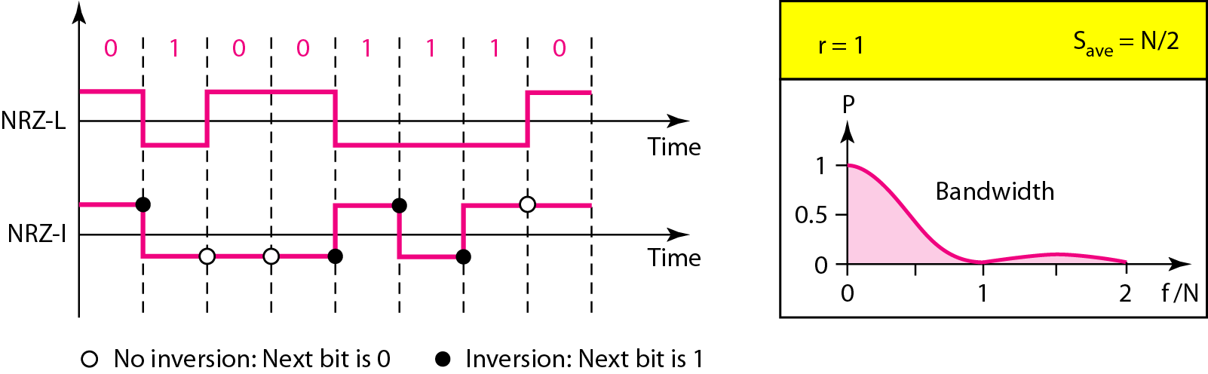
Figure 4.6 Polar NRZ-L and NRZ-I schemes

Slide 29
Line coding schemes
Limitations of NRZ scheme
Presence of dc component
When the voltage level in a digital signal is constant for a while, the spectrum creates very low frequencies.
These frequencies around zero, called DC(direct –current) components, present problems for a system that cannot pass low frequencies(most channels are bandpass) or a system that uses electrical coupling(via transformer)
E.g. a telephone line cannot pass frequencies below 200Hz

Slide 30
Line coding schemes
Limitations of NRZ scheme
Both NRZ-L and NRZ-I will cause baseline wandering problem
Baseline wandering –In decoding a digital signal, the receiver will evaluate the average power of the received signal (called the baseline) and use that to determine the value of the incoming data elements. If the incoming signal does not vary over a long period of time, the baseline will drift and thus cause errors in detection of incoming data elements.
In NRZ-I ,it is twice as severe in NRZ-L
A good line encoding scheme will prevent long runs of fixed amplitude.

Slide 31
Line coding schemes
Limitations of NRZ scheme
Lack of synchronization capability
If there is a long sequence of 0’s or 1’s ,the output will be a constant voltage for a long period of time.
During that ,any drift between the clocks of transmitter and receiver will result in loss of synchronization between the two.

Slide 32
Line coding schemes
Polar - RZ
The Return to Zero (RZ) scheme uses three voltage values. +, 0, -.
Each symbol has a transition in the middle. Either from high to zero or from low to zero.
This scheme has more signal transitions (two per symbol) and therefore requires a wider bandwidth.
No DC components or baseline wandering.
Self synchronization - transition indicates symbol value.
More complex as it uses three voltage level. It has no error detection capability.

Slide 33
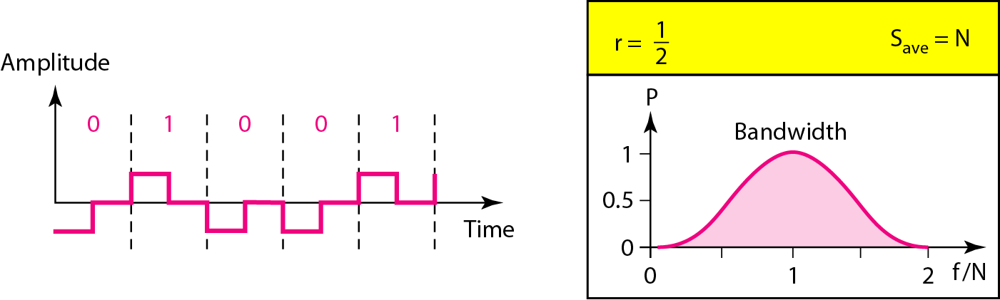
Figure 4.7 Polar RZ scheme

Slide 34
Line coding schemes
Biphase
Manchester encoding
Differential Manchester encoding

Slide 35
Polar - Biphase: Manchester and Differential Manchester
Manchester coding
consists of combining the NRZ-L and RZ schemes.
Every symbol has a level transition in the middle: from high to low or low to high.
Uses only two voltage levels.
transition serves as clock and data
low to high represents one
high to low represents zero
used by IEEE 802.3 (Ethernet LAN) with baseband coaxial cable and twisted pair

Slide 36
Polar - Biphase: Manchester and Differential Manchester
Differential Manchester coding
consists of combining the NRZ-I and RZ schemes.
Every symbol has a level transition in the middle.
But the level at the beginning of the symbol is determined by the symbol value.
One symbol causes a level change the other does not.
Mid-bit transition is clocking only
transition at start of bit period representing 0
no transition at start of bit period representing 1
used by IEEE 802.5 (Token Ring LAN) with shielded twisted pair.
This is a differential encoding scheme

Slide 37
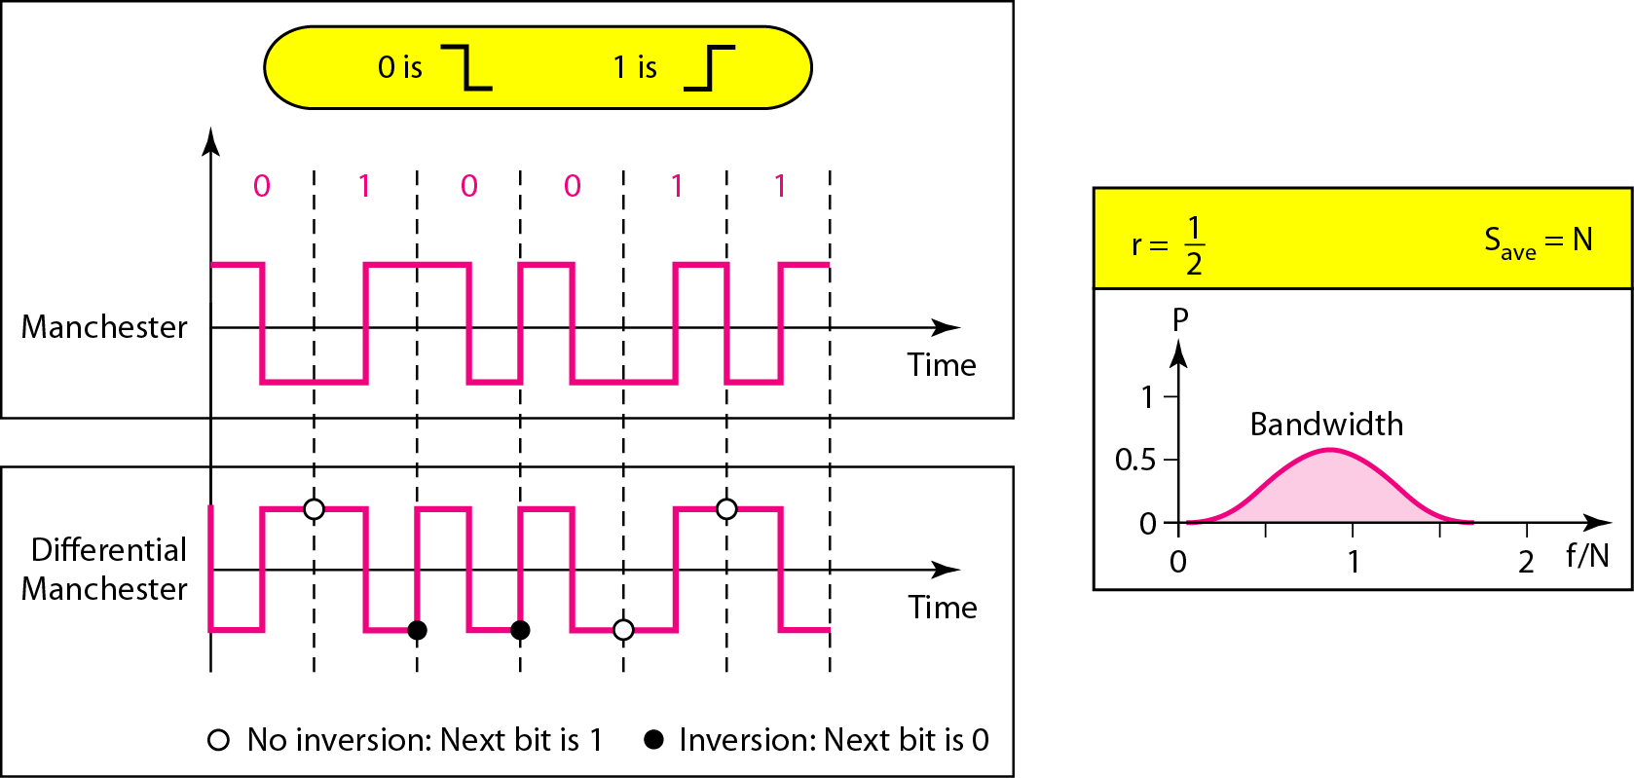
Figure 4.8 Polar biphase: Manchester and differential Manchester schemes

Slide 38
Biphase Pros and Cons
Con
at least one transition per bit time and possibly two
maximum modulation rate(signal rate) is twice as NRZ
requires more bandwidth
Pros
synchronization on mid-bit transition (self clocking codes)
Receiver can synchronize on that transition
has no dc component, because each bit has a positive and negative voltage contribution.
No baseline wandering
has error detection
Absence of an expected transition can be used to detect errors.
Noise on the line has to invert both the signal before and after the expected transition to cause an undetected error.

Slide 39
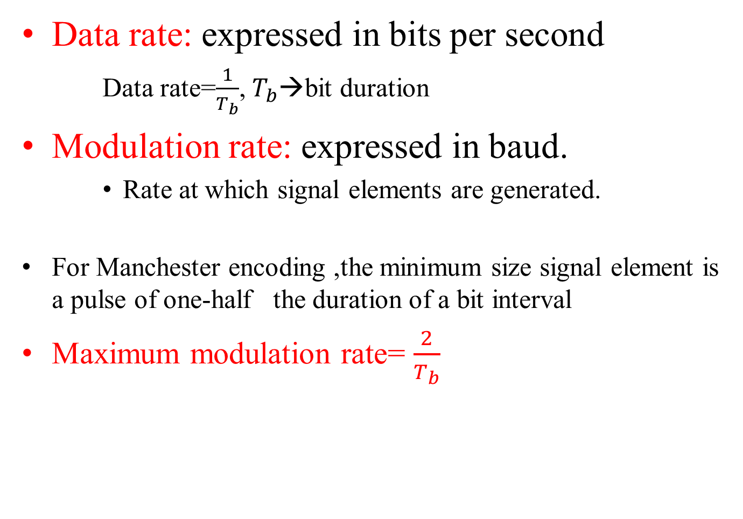
Modulation rate
Data rate: expressed in bits per second
Data rate=$\frac{1}{T_{b}}$, $T_{b}$→bit duration
Modulation rate: expressed in baud.
Rate at which signal elements are generated.
For Manchester encoding ,the minimum size signal element is a pulse of one-half the duration of a bit interval
Maximum modulation rate= $\frac{2}{T_{b}}$

Slide 40
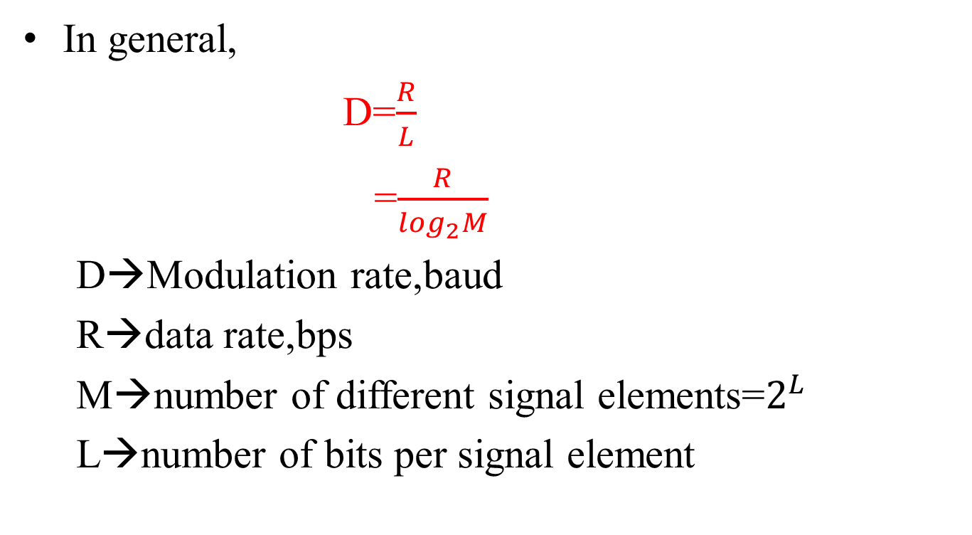
Modulation rate
In general,
D=$\frac{R}{L}$
=$\frac{R}{\log_{2}M}$
D→Modulation rate,baud
R→data rate,bps
M→number of different signal elements=$2^{L}$
L→number of bits per signal element

Slide 41
Bipolar
In bipolar encoding, there are 3 voltage levels: - positive, negative and zero to represent the symbols (no transitions to zero as in RZ).
Voltage level for one data element is at “0” and the other alternates between positive & negative.
Two variations of bipolar encoding
Bipolar-AMI
Pseudoternary
Bipolar Alternate Mark Inversion (AMI) - the “0” symbol is represented by zero voltage and the “1” symbol alternates between +V and -V.
Pseudoternary is the reverse of AMI.

Slide 42
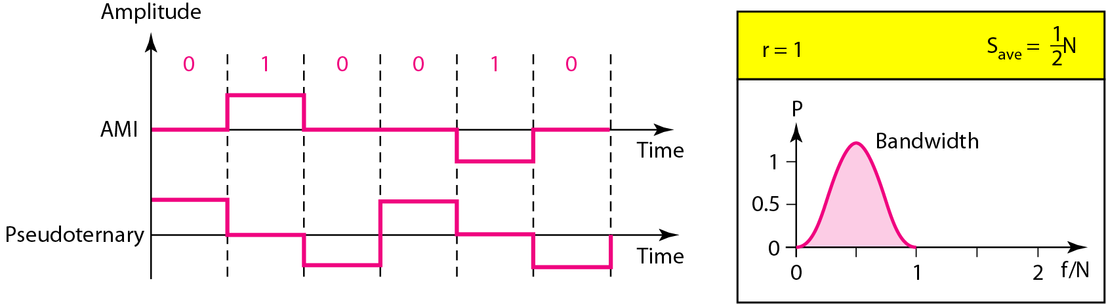
Figure 4.9 Bipolar schemes: AMI and pseudoternary

Slide 43
Bipolar
It is a better alternative to NRZ.
Bipolar has the same signal rate as NRZ.
Has no DC component or baseline wandering.
This is because ,even though we have a long sequence of 1’s,the voltage alternates between positive and negative, it is not constant.
For a long sequence of 0’s,the voltage remains constant, but its amplitude is zero, which is same as having no DC component.
i.e. A sequence that creates a constant zero voltage does not have a DC component.
The concentration of energy in bipolar encoding is around frequency N/2.
Bipolar coding is used in long-distance communication, and has no self synchronization because long runs of “0”s results in no signal transitions.
No error detection.

Slide 44
Scrambling Techniques
Although the biphase techniques have achieved widespread use in local area network applications at relatively high data rates (upto 10 Mbps),they have not been widely used in long-distance applications.
The reason is that it require a high signaling rate i.e. a wider bandwidth requirement.
To solve this Scrambling schemes are used.
i.e. Sequences that would result in constant voltage level on the line are replaced by filling sequences that will provide sufficient transition for the receiver’s clock to maintain synchronization.

Slide 45
Scrambling Techniques
The filling sequence must be recognized by the receiver and replaced with the original data sequence.
The filling sequence is the same length as the original sequence ,so there is no data rate penalty.
The design goals for this approach are:
No dc component
No long sequences of zero-level line signals.
No reduction in data rate.
Error-detection capability.

Slide 46
Scrambling Techniques
Two scrambling techniques are :
B8ZS
HDB3

Slide 47
Scrambling Techniques
B8ZS[Bipolar with 8 zero substitution]
Commonly used in North America
This scheme is based on bipolar-AMI.
The drawback of AMI code is that a long string of zeros may result in loss of synchronization.
To overcome this problem, the encoding is amended with the following rules:
If an octet of all zeros occurs and the last voltage pulse preceding this octet was positive ,then eight zeros of the octet are encoded as 000+-0-+ (000VB0VB)
If an octet of all zeros occurs and the last voltage preceding the octet was negative ,then the eight zeros of the octet are encoded as 000-+0+- (000VB0VB)

Slide 48
Scrambling Techniques
B-Valid Bipolar signal
V-Bipolar violation
This technique forces two code violations (signal patterns not allowed in AMI) of the AMI code.
The receiver recognizes the pattern and interprets the octet as consisting of all zeros.

Slide 49
Scrambling Techniques
HDB3(High-Density Bipolar-3 Zeros)
A coding scheme that is commonly used in Europe and Japan
It is also based on AMI encoding
In this case, the scheme replaces strings of four zeros with sequences containing one or two pulses.
In each case ,the fourth zero is replaced with a code violation.
In addition, a rule is needed to ensure that successive violations are of the alternate polarity so that no dc component is introduced.
Thus if the last violation was positive ,this violation must be negative and vice versa.

Slide 50
Scrambling Techniques
This condition is tested for by determining:
1)whether the number of pulses since the last violation is even or odd and
2)the polarity of the first pulse before the occurrence of the four zeros

Slide 51
Scrambling Techniques
This is given in the table below:
Polarity of preceding pulses | Number of Bipolar pulses(ones) since last substitution
 | Odd | Even
- | 000- | +00+
+ | 000+ | -00-

Slide 52
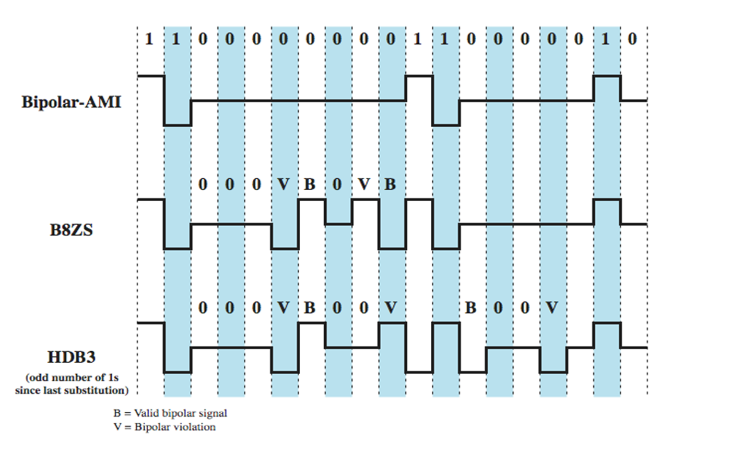
B8ZS and HDB3

Slide 53
Analog Data to Digital Signals
The process of transforming analog data into digital data is known as digitization.
After the digital data are created (digitization),any one of the line coding techniques can be used to convert digital data to digital signal.
After converting analog data to digital data , 3 things can happen
be transmitted using NRZ-L
be transmitted using code other than NRZ-L
be converted to analog signal using one of the modulation techniques.

Slide 54
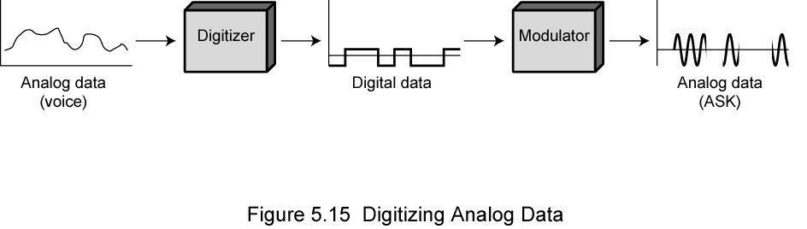
Digitizing Analog Data
The procedure for converting analog data into digital data and then converted to an analog ASK signal is shown below:
Notes:
Stallings DCC8e Figure 5.15 illustrates the 3rd alternative, which shows voice data that are digitized and then converted to an analog ASK signal. This allows digital transmission in the sense defined in Chapter 3. The voice data, because they have been digitized, can be treated as digital data, even though transmission requirements (eg. use of microwave) dictate that an analog signal be used.

Slide 55
Analog Data to Digital Signals
The device used for converting analog data into digital form for transmission and subsequently recovering the original analog data from the digital is known as codec(coder-decoder)
Two principal techniques used in codecs:
Pulse code modulation
Delta modulation

Slide 56
Pulse Code Modulation(PCM)
Pulse code modulation is based on sampling theorem.
Sampling theorem
If a signal f(t) is sampled at regular intervals of time and at a rate higher than twice the highest signal frequency, then the samples contain all information of the original signal. The function f(t) may be reconstructed from these samples by the use of a low-pass filter.
Hence if voice data is limited to frequencies below 4000 Hz (a conservative procedure for intelligibility), 8000 samples per second would be sufficient to characterize the voice signal completely.

Slide 57
Pulse Code Modulation(PCM)
These samples are analog samples and are called Pulse Amplitude Modulation (PAM) samples.
To convert to digital ,each of these analog samples must be assigned a binary code.
Fig . Shows an example.

Slide 58
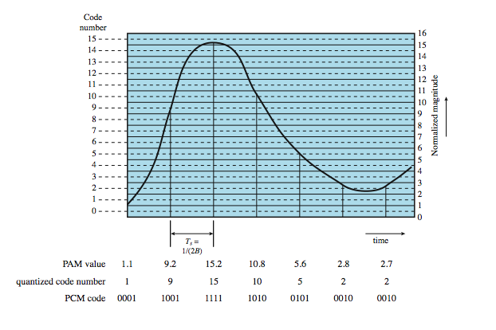
PCM Example
Notes:
Stallings DCC8e Figure 5.16 shows an example in which the original signal is assumed to be bandlimited with a bandwidth of B. PAM samples are taken at a rate of 2B, or once every T_{s} = 1/2B seconds. Each PAM sample is approximated by being quantized into one of 16 different levels. Each sample can then be represented by 4 bits. But because the quantized values are only approximations, it is impossible to recover the original signal exactly. By using an 8-bit sample, which allows 256 quantizing levels, the quality of the recovered voice signal is comparable with that achieved via analog transmission. Note that this implies that a data rate of 8000 samples per second × 8 bits per sample = 64 kbps is needed for a single voice signal.

Slide 59
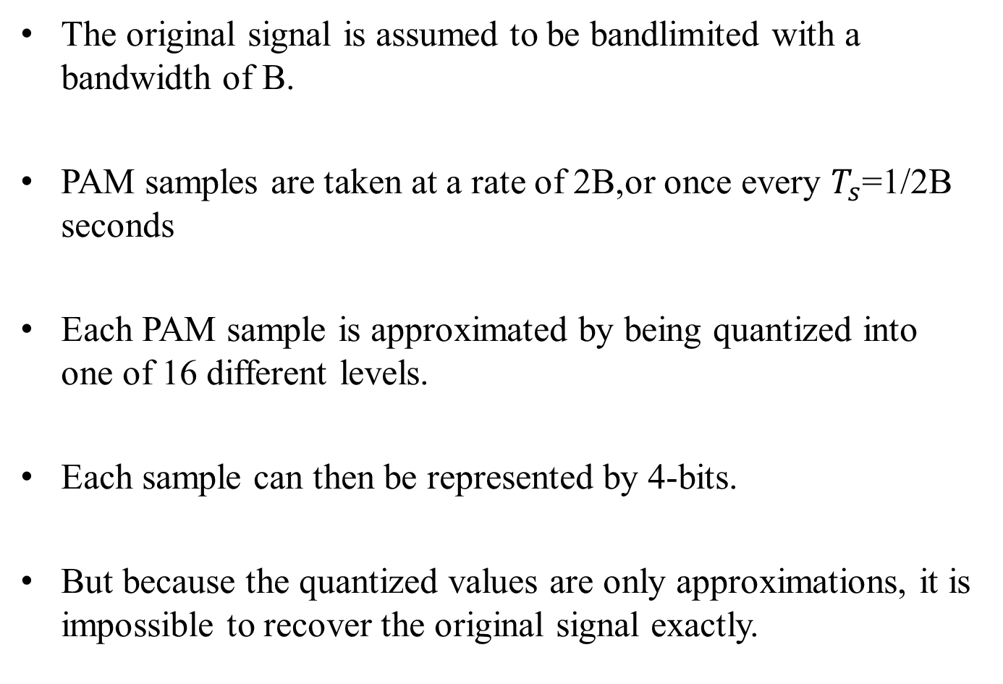
PCM Example
The original signal is assumed to be bandlimited with a bandwidth of B.
PAM samples are taken at a rate of 2B,or once every $T_{s}$=1/2B seconds
Each PAM sample is approximated by being quantized into one of 16 different levels.
Each sample can then be represented by 4-bits.
But because the quantized values are only approximations, it is impossible to recover the original signal exactly.

Slide 60
PCM Example
By using an 8-bit sample, which allows 256 quantizing levels ,the quality of the recovered voice signal is comparable with that achieved via analog transmission.
This implies that a data rate of 8000 samples per second× 8 bits per sample= 64 kbps is needed for a voice channel.
The choice of L,the number of levels ,depends on the range of the amplitudes of the analog signal and how accurately we need to recover the signal.

Slide 61
PCM Example
If the signal fluctuates between two values only, we need only two levels.
In signals like noise, which has many amplitude values ,we need more quantization levels.
In audio, L is normally chosen as 256.
In video, it is normally thousands.
Lower value of L increases quantization error.

Slide 62
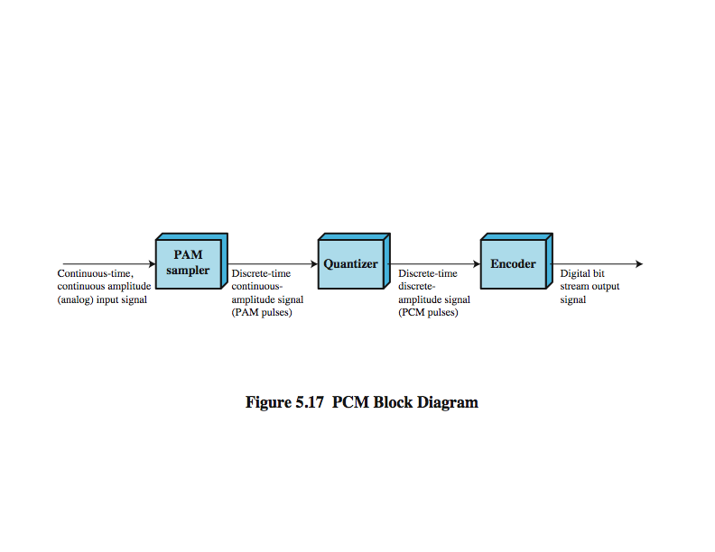
PCM Block Diagram
PCM starts with a continuous-time ,continuous-amplitude(analog ) signal,from which a digital signal is produced.
The digital signal consists of blocks of n-bits ,where each n-bit number is the amplitude of the PCM pulse.
On reception ,the process is reversed to reproduce the analog signal.
Notes:
Thus, PCM starts with a continuous-time, continuous-amplitude (analog) signal, from which a digital signal is produced, as shown in Stallings DCC8e Figure 5.17. The digital signal consists of blocks of n bits, where each n-bit number is the amplitude of a PCM pulse. On reception, the process is reversed to reproduce the analog signal. Notice, however, that this process violates the terms of the sampling theorem. By quantizing the PAM pulse, the original signal is now only approximated and cannot be recovered exactly. This effect is known as quantizing error or quantizing noise. Each additional bit used for quantizing increases SNR by about 6 dB, which is a factor of 4.

Slide 63
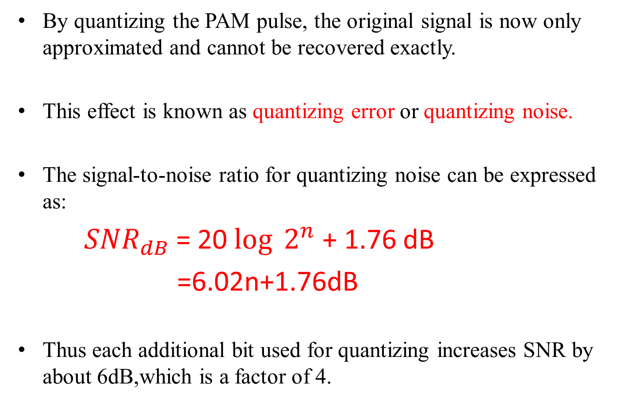
Pulse Code Modulation
By quantizing the PAM pulse, the original signal is now only approximated and cannot be recovered exactly.
This effect is known as quantizing error or quantizing noise.
The signal-to-noise ratio for quantizing noise can be expressed as:
${SNR}_{dB}$= 20 ${\log{2}}^{n}$ + 1.76 dB
=6.02n+1.76dB
Thus each additional bit used for quantizing increases SNR by about 6dB,which is a factor of 4.

Slide 64
Non-linear encoding
PCM scheme can refined using a technique called non-linear encoding, which means ,the quantization levels are not equally spaced.
Problem with equal spacing is that the mean absolute error for each sample is the same, regardless of the signal level.
Consequently, lower amplitude values are relatively more distorted.
By using a greater number of quantizing steps for signals of low amplitude and a smaller number of quantizing steps for signals of large amplitude, a marked reduction in overall signal distortion is achieved.

Slide 65
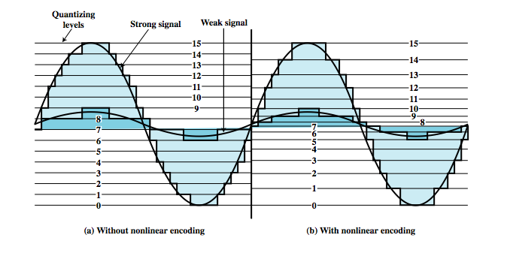
Non-Linear Coding
Notes:
Typically, the PCM scheme is refined using a technique known as nonlinear encoding, which means, in effect, that the quantization levels are not equally spaced. The problem with equal spacing is that the mean absolute error for each sample is the same, regardless of signal level. Consequently, lower amplitude values are relatively more distorted. By using a greater number of quantizing steps for signals of low amplitude, and a smaller number of quantizing steps for signals of large amplitude, a marked reduction in overall signal distortion is achieved, as shown in Stallings DCC8e Figure 5.18.
Nonlinear encoding can significantly improve the PCM SNR ratio. For voice signals, improvements of 24 to 30 dB have been achieved.

Slide 66
Companding
The same effect of non-linear encoding can be achieved using uniform quantizing but companding(compressing and expanding) the input analog signal).
Companding is the process that compresses the intensity range of a signal by imparting more gain to weak signals than to strong signals on input.
At the output the reverse operation is performed.
The typical companding function is shown in fig.

Slide 67
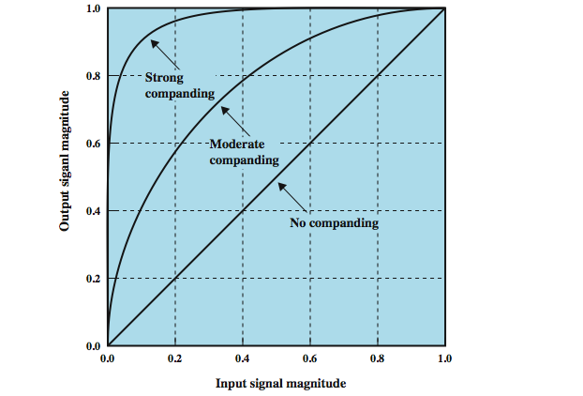
Companding
Notes:
The same effect can be achieved by using uniform quantizing but companding (compressing-expanding) the input analog signal. Companding is a process that compresses the intensity range of a signal by imparting more gain to weak signals than to strong signals on input. At output, the reverse operation is performed. Stallings DCC8e Figure 5.19 shows typical companding functions. Note that the effect on the input side is to compress the sample so that the higher values are reduced with respect to the lower values. Thus, with a fixed number of quantizing levels, more levels are available for lower-level signals. On the output side, the compander expands the samples so the compressed values are restored to their original values.

Slide 68
Companding
The effect on the input side is to compress the sample so that the higher values are reduced with respect to the lower values.
Thus with a fixed number of quantizing levels, more levels are available for lower level signals.
On the output side, the compander expands the samples so the compressed values are restored to their original values.
Non-linear encoding can significantly improve the PCM SNR ratio(for voice signals about 24 to 30 dB have been achieved)

Slide 69
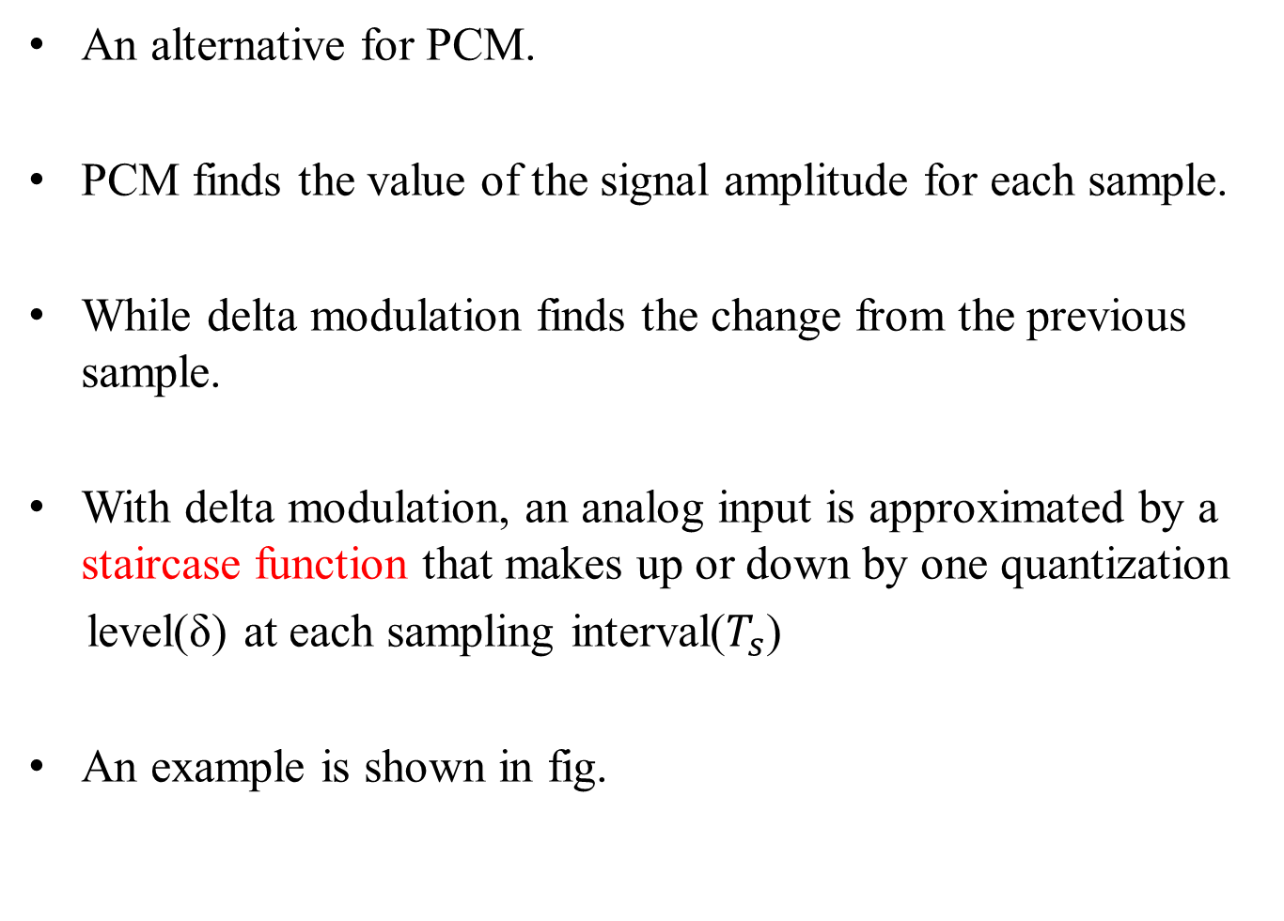
Delta Modulation
An alternative for PCM.
PCM finds the value of the signal amplitude for each sample.
While delta modulation finds the change from the previous sample.
With delta modulation, an analog input is approximated by a staircase function that makes up or down by one quantization
level(δ) at each sampling interval($T_{s}$)
An example is shown in fig.

Slide 70
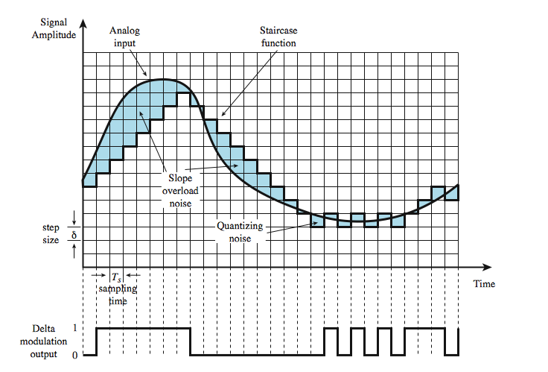
Delta Modulation Example
Notes:
Stallings DCC8e Figure 5.20 shows an example where the staircase function is overlaid on the original analog waveform. A 1 is generated if the staircase function is to go up during the next interval; a 0 is generated otherwise. The transition (up or down) that occurs at each sampling interval is chosen so that the staircase function tracks the original analog waveform as closely as possible.
There are two important parameters in a DM scheme: the size of the step assigned to each binary digit, δ, and the sampling rate. As the above figure illustrates, δ must be chosen to produce a balance between two types of errors or noise. When the analog waveform is changing very slowly, there will be quantizing noise. This noise increases as δ is increased. On the other hand, when the analog waveform is changing more rapidly than the staircase can follow, there is slope overload noise. This noise increases as δ is decreased. It should be clear that the accuracy of the scheme can be improved by increasing the sampling rate. However, this increases the data rate of the output signal.

Slide 71
Delta Modulation
The staircase function is overlaid on the original wave form.
The important characteristic of this staircase function is that its behavior is binary.
At each sampling time ,the function moves up or down a constant amount δ.
Thus ,the output of the delta modulation process can be represented as a single binary digit for each samples.
A bit stream is produced by approximating the derivative of an analog signal rather than its amplitude.

Slide 72
Delta Modulation
As 1 is generated if the staircase function is to go up during the next interval ; a 0 is generated otherwise.
The transition (up or down) that occurs at each sampling interval is chosen so that the staircase function tracks the original waveform as closely as possible.
The logic of the process is illustrated in fig.

Slide 73
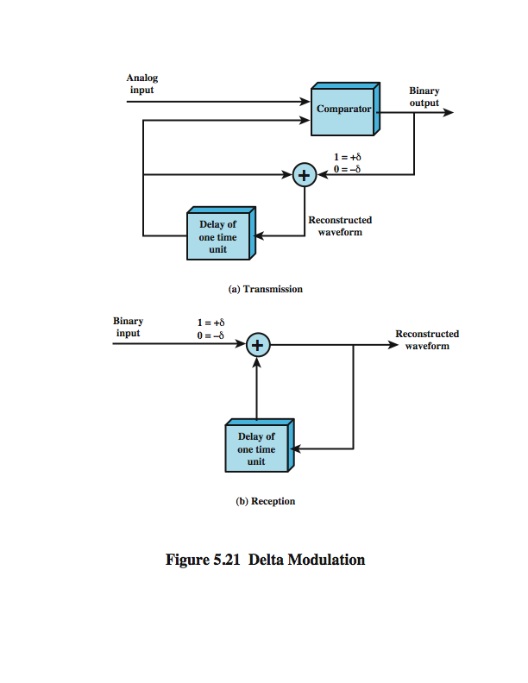
Delta Modulation Operation
Notes:
Stallings DCC8e Figure 5.21 illustrates the logic of the process, which is essentially a feedback mechanism. For transmission, the following occurs: At each sampling time, the analog input is compared to the most recent value of the approximating staircase function. If the value of the sampled waveform exceeds that of the staircase function, a 1 is generated; otherwise, a 0 is generated. Thus, the staircase is always changed in the direction of the input signal. The output of the DM process is therefore a binary sequence that can be used at the receiver to reconstruct the staircase function. The staircase function can then be smoothed by some type of integration process or by passing it through a lowpass filter to produce an analog approximation of the analog input signal.

Slide 74
Delta Modulation Operation
For transmission, the following occurs:
At each sampling time ,the analog input is compared to the most recent value of the approximating staircase function.
If the value of the sampled waveform exceeds that of the staircase function , a 1 is generated ,otherwise a 0 is generated.
Thus the staircase is always changed in the direction of the input signal
The output of the DM process is therefore a binary sequence that can be used at the receiver to reconstruct the staircase function.
The staircase function can then be smoothed by some type of integration process or by passing it through a low pass filter to produce an analog approximation of the analog input signal.

Slide 75
Delta Modulation
There are two important parameters in a Delta modulation scheme.
The size of the step assigned to each binary digit,δ and
The sampling rate
δ must be chosen to produce a balance between two types of errors or noise.
When the analog waveform is changing very slowly ,there will be a quantizing noise.
This noise increases as δ is increased.
When an analog waveform is changing more rapidly than the staircase can follow, there is a slope overhead noise.
This noise increases as δ is decreased.

Slide 76
PCM verses Delta Modulation
DM has simplicity compared to PCM
but has worse SNR
issue of bandwidth used
e.g. for good voice reproduction with PCM
with 128 levels (7 -bit coding) & voice bandwidth 4khz
need 8000 x 7 = 56kbps for PCM encoded digital data .
data compression can improve on this
still growing demand for digital signals in transmitting analog data due to various reasons:
Since repeaters are used instead of amplifiers no cumulative noise.
TDM is used for digital signals where there is no intermodulation noise
conversion to digital signaling allows use of efficient switching techniques.
PCM preferred to DM for analog signals
Notes:
The principal advantage of DM over PCM is the simplicity of its implementation. In general, PCM exhibits better SNR characteristics at the same data rate. Good voice reproduction via PCM can be achieved with 128 quantization levels, or 7-bit coding (2⁷ = 128). A voice signal, conservatively, occupies a bandwidth of 4 kHz. Thus, according to the sampling theorem, samples should be taken at a rate of 8000 samples per second. This implies a data rate of 8000 × 7 = 56 kbps for the PCM-encoded digital data. But using the Nyquist criterion from Chapter 3, this digital signal could require on the order of 28 kHz of bandwidth. Even more severe differences are seen with higher bandwidth signals. For example, a common PCM scheme for color television uses 10-bit codes, which works out to 92 Mbps for a 4.6-MHz bandwidth signal. In spite of these numbers, digital techniques continue to grow in popularity for transmitting analog data. The principal reasons for this are
• Because repeaters are used instead of amplifiers, there is no cumulative noise.
• use time division multiplexing (TDM) for digital signals with no intermodulation noise, verses of the frequency division multiplexing (FDM) used for analog signals.
• The conversion to digital signaling allows the use of the more efficient digital switching techniques.
Furthermore, techniques have been developed to provide more efficient codes.
Studies also show that PCM-related techniques are preferable to DM-related techniques for digitizing higher frequency analog signals that represent digital data.

Slide 77
Digital Data to Analog Signals
The most familiar use of this transformation is for transmitting digital data through the public telephone network.
The telephone network was designed to receive, switch and transmit analog signals in the voice- frequency range of about 300Hz to 3400Hz.
It cannot handle digital signals.
So the digital devices are connected to the network via modem(modulator-demodulator).
For telephone network, modems are used to produce signals in the voice- frequency range.

Slide 78
Digital Data to Analog Signals
Same techniques can be used to produce signal at higher frequencies (e.g. microwave)
The process of converting digital or analog data to analog signal is called modulation.
Modulation involves operation on one or more of the three characteristics of a carrier signal:
Amplitude
Frequency
Phase

Slide 79
Figure 5-22
Digital to Analog Encoding

Slide 80
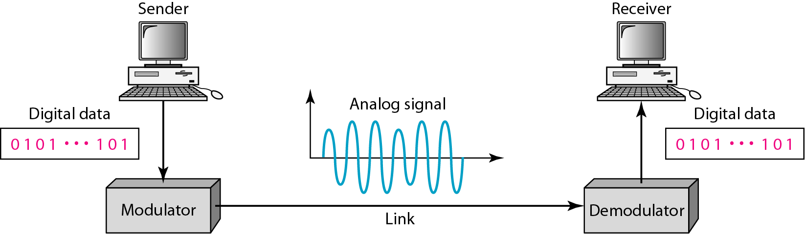
Figure 5.1 Digital-to-analog conversion

Slide 81
Digital Data to Analog Signals
There are three basic encoding or modulation techniques for transforming digital data into analog signals:
Amplitude Shift Keying
Frequency Shift Keying
Phase Shift Keying
In all the cases ,the resulting signal occupies a bandwidth centered on the carrier frequency.

Slide 82
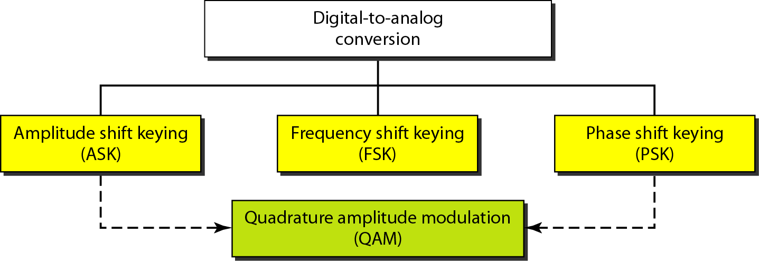
Figure 5.2 Types of digital-to-analog conversion

Slide 83
Amplitude Shift Keying
In Amplitude shift keying(ASK) ,the two binary values are represented by two different amplitudes of the carrier frequency.
One of the amplitude is zero
i.e. one binary digit is represented by the presence of the carrier at constant amplitude and the other by the absence of the carrier.
For a carrier signal, the resulting transmitted signal for one bit time is

Slide 84
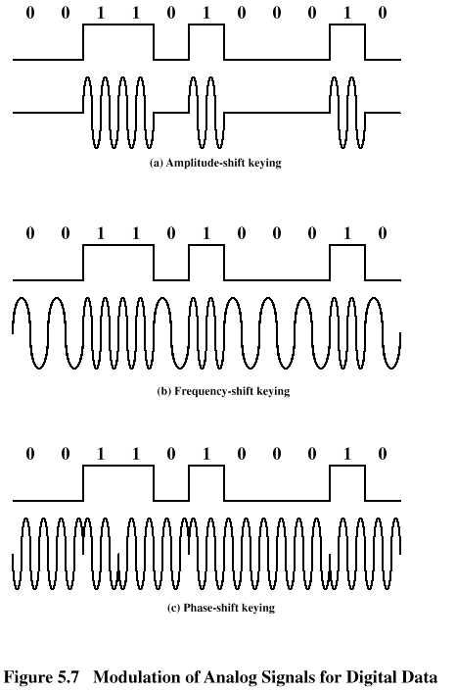
Amplitude Shift Keying

Slide 85
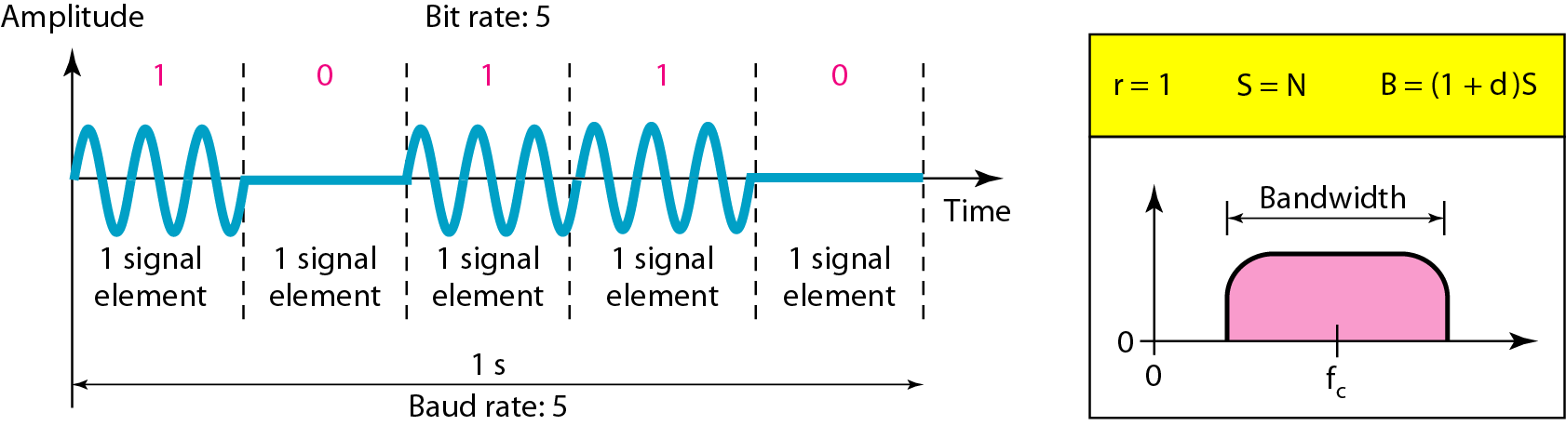
Figure 5.3 Binary amplitude shift keying

Slide 86
Amplitude Shift Keying
ASK is susceptible to sudden gain changes and is rather inefficient modulation technique.
On voice-grade lines ,it is typically used only up to 1200bps.
ASK technique is used to transmit digital data over optical fibers.
The light-emitting diode(LEDs) transmitters use ASK.
i.e one signal element is represented by a light pulse while the other signal element is represented by the absence of light.

Slide 87
Amplitude Shift Keying
Laser transmitters normally have a fixed “bias “ current that causes the device to emit low light level.
This low level represents one signal element ,while a higher amplitude light wave represents another signal element.

Slide 88
Frequency Shift Keying(FSK)
The most common form of FSK is binary FSK(BFSK),in which two binary values are represented by two different frequencies near the carrier frequency.
The resulting transmitted signal for one bit time is
BFSK
Where f₁ and f₂ are offset from carrier frequency f_{c} by equal but opposite amounts

Slide 89
Frequency Shift Keying (FSK)
Less susceptible to error than ASK
up to 1200bps on voice grade lines
Used for high frequency (3 to 30 MHz) radio transmission
Used at even higher frequencies on LANs using coaxial cables

Slide 90
Frequency Shift Keying
Multiple FSK(MFSK)
A signal that is more bandwidth efficient but also more susceptible to error is Multiple FSK ,in which more than two frequencies are used.
In this case, each signaling element represents more than one bit.

Slide 91
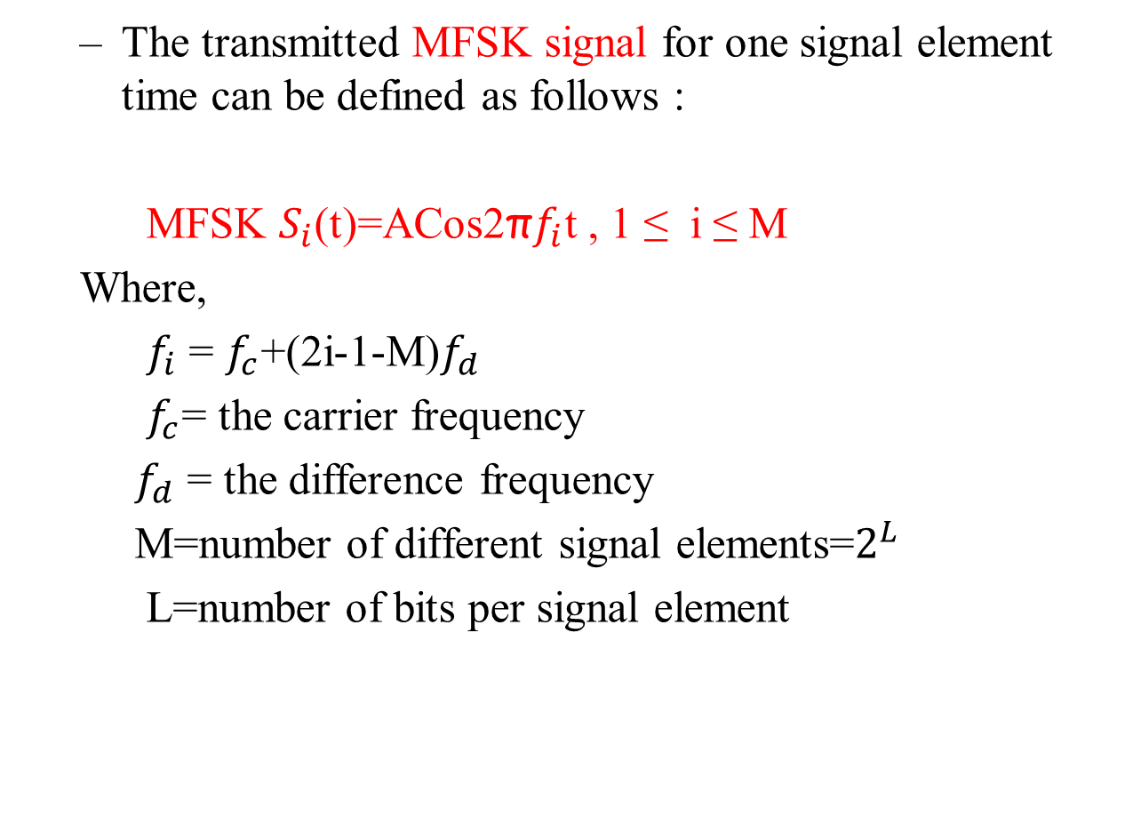
Frequency Shift Keying
The transmitted MFSK signal for one signal element time can be defined as follows :
MFSK $S_{i}$(t)=ACos2π$f_{i}$t , 1 ≤ i ≤ M
Where,
$f_{i}$ = $f_{c}$+(2i-1-M)$f_{d}$
$f_{c}$= the carrier frequency
$f_{d}$ = the difference frequency
M=number of different signal elements=$2^{L}$
L=number of bits per signal element

Slide 92
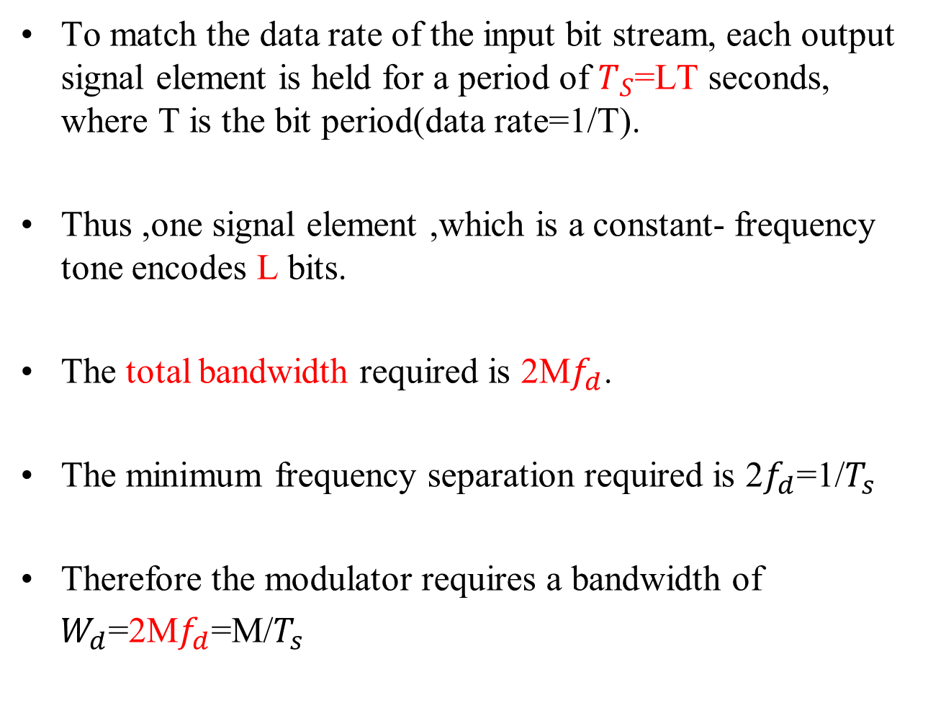
Frequency Shift Keying
To match the data rate of the input bit stream, each output signal element is held for a period of $T_{S}$=LT seconds, where T is the bit period(data rate=1/T).
Thus ,one signal element ,which is a constant- frequency tone encodes L bits.
The total bandwidth required is 2M$f_{d}$.
The minimum frequency separation required is 2$f_{d}$=1/$T_{s}$
Therefore the modulator requires a bandwidth of
$W_{d}$=2M$f_{d}$=M/$T_{s}$

Slide 93
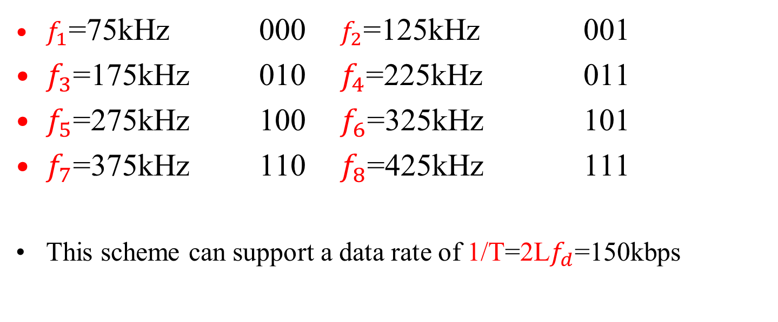
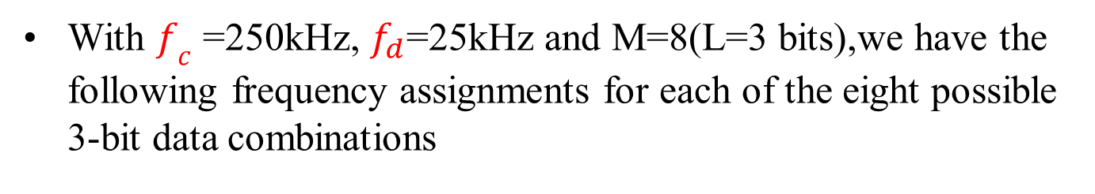
Frequency Shift Keying
With $f_{c}$ =250kHz, $f_{d}$=25kHz and M=8(L=3 bits),we have the following frequency assignments for each of the eight possible 3-bit data combinations
$f_{1}$=75kHz 000 $f_{2}$=125kHz 001
$f_{3}$=175kHz 010 $f_{4}$=225kHz 011
$f_{5}$=275kHz 100 $f_{6}$=325kHz 101
$f_{7}$=375kHz 110 $f_{8}$=425kHz 111
This scheme can support a data rate of 1/T=2L$f_{d}$=150kbps

Slide 94

Example
Let M=4.An input bit stream of 20 bits is encoded 2 bits a time ,with each of the four possible 2-bit combinations transmitted at a different frequency .in the fig., the frequency(y-axis) is shown as a function of time(x-axis).Each column represents a time unit $T_{s}$in which a single 2-bit signal element is transmitted .the shaded rectangle in the column indicates the frequency transmitted during that time unit.

Slide 95
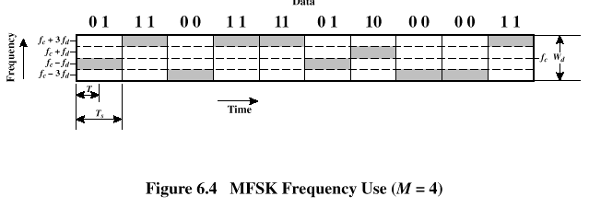
Multiple Frequency-Shift Keying (MFSK)

Slide 96
Frequency Shift Keying (FSK)
Full-duplex transmission over voice grade line
In one direction f_{c} is 1170 Hz with f₁ and f₂ given by 1170+100=1270 Hz and 1170–100=1070 Hz
In other direction f_{c} is 2125 Hz with f₁ and f₂ given by 2125+100=2225 Hz and 2125–100=2025 Hz

Slide 97
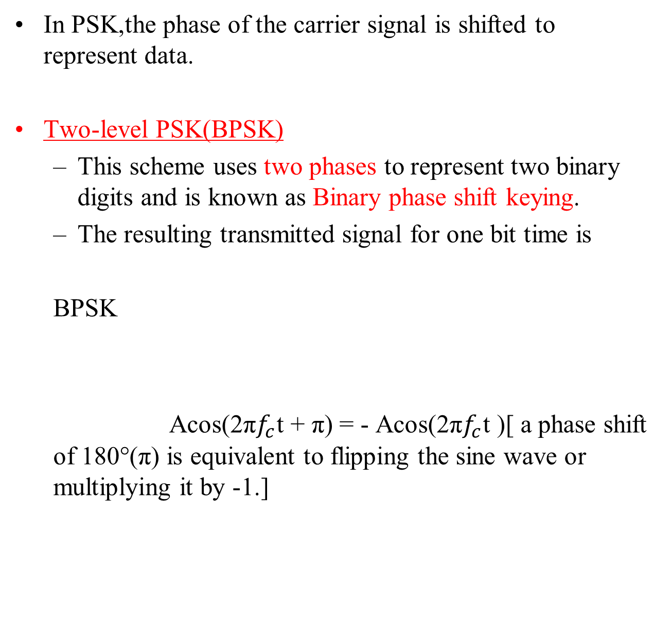
Phase Shift Keying
In PSK,the phase of the carrier signal is shifted to represent data.
Two-level PSK(BPSK)
This scheme uses two phases to represent two binary digits and is known as Binary phase shift keying.
The resulting transmitted signal for one bit time is
BPSK
Acos(2π$f_{c}$t + π) = - Acos(2π$f_{c}$t )[ a phase shift of 180°(π) is equivalent to flipping the sine wave or multiplying it by -1.]

Slide 98
Phase Shift Keying

Slide 99
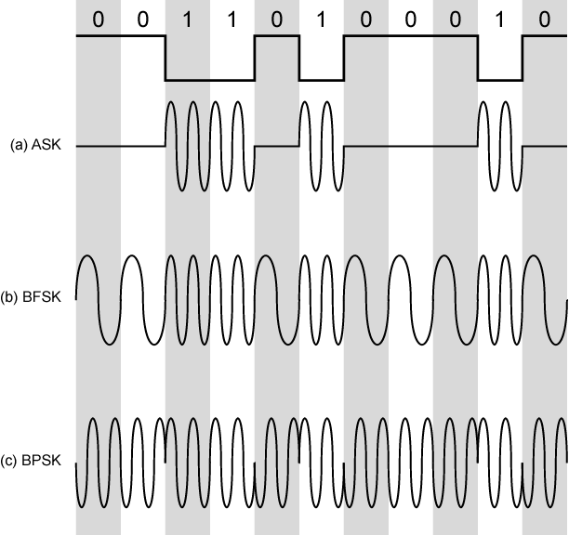
Modulation Techniques

Slide 100
Differential PSK
An alternative of two-level PSK is Differential PSK(DPSK)
In this scheme, a binary 0 is represented by sending a signal burst of the same phase as the previous signal burst sent.
A binary 1 is represented by sending a signal burst of opposite phase to the preceding one.
The term differential refers to the fact that the phase shift is with reference to the previous bit transmitted rather than to some constant reference signal.
In differential encoding, the information to be transmitted is represented in terms of the changes between successive data symbols rather than signal elements themselves.

Slide 101
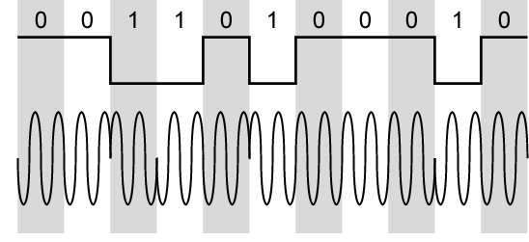
Differential PSK

Slide 102
Four-level PSK
More efficient use of bandwidth can be achieved if each signal element represents more than one bit.
In BPSK, a phase shift of 180° is used
In four-level PSK a common encoding technique called quadrature phase shift keying (QPSK) ,which uses phase shifts separated by multiples of π/2(90°)
QPSK
Thus each signal element represents two bits rather than one.

Slide 103
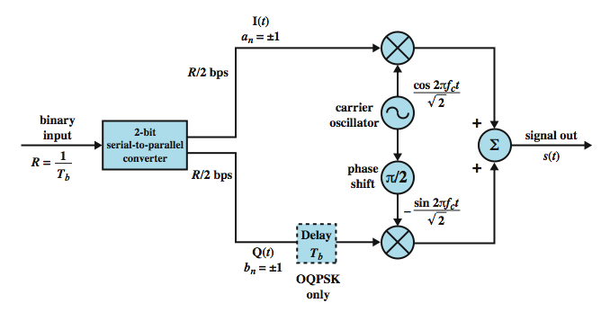
QPSK And OQPSK Modulators
Fig shows the QPSK modulation scheme in general:
Notes:
Stallings DCC8e Figure 5.11 shows the QPSK modulation scheme in general terms. The input is a stream of binary digits with a data rate of R = 1/T_{b}, where T_{b} is the width of each bit. This stream is converted into two separate bit streams of R/2 bps each, by taking alternate bits for the two streams. The two data streams are referred to as the I (in-phase) and Q (quadrature phase) streams. The streams are modulated on a carrier of frequency f_{c} by multiplying the bit stream by the carrier, and the carrier shifted by 90˚. The two modulated signals are then added together and transmitted. Thus, the combined signals have a symbol rate that is half the input bit rate.
This figure also shows the variation of QPSK known as offset QPSK (OQPSK), or orthogonal QPSK. The difference is that a delay of one bit time is introduced in the Q stream. Because OQPSK differs from QPSK only by the delay in the Q stream, its spectral characteristics and bit error performance are the same as that of QPSK.
“11” => π/4, “01” => 3π/4, “00” => -3π/4, “10” => -π/4, single bit change for π/2 change in phase

Slide 104
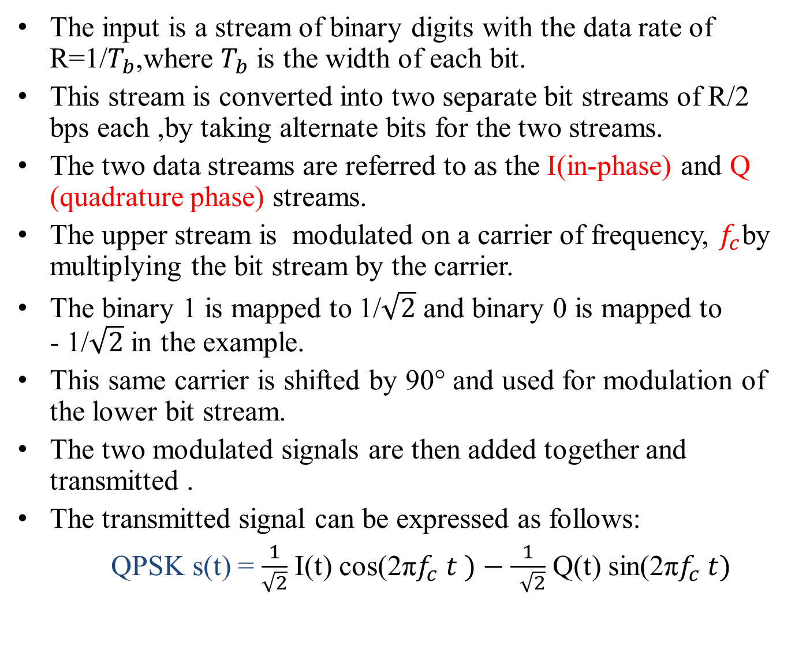
QPSK Modulators
The input is a stream of binary digits with the data rate of R=1/$T_{b}$,where $T_{b}$ is the width of each bit.
This stream is converted into two separate bit streams of R/2 bps each ,by taking alternate bits for the two streams.
The two data streams are referred to as the I(in-phase) and Q (quadrature phase) streams.
The upper stream is modulated on a carrier of frequency, $f_{c}$by multiplying the bit stream by the carrier.
The binary 1 is mapped to 1/$\sqrt{2}$ and binary 0 is mapped to - 1/$\sqrt{2}$ in the example.
This same carrier is shifted by 90° and used for modulation of the lower bit stream.
The two modulated signals are then added together and transmitted .
The transmitted signal can be expressed as follows:
QPSK s(t) = $\frac{1}{\sqrt{2}}$ I(t) cos(2π$f_{c} t )−\frac{1}{ \sqrt{2}}$ Q(t) sin(2π$f_{c} t)$

Slide 105
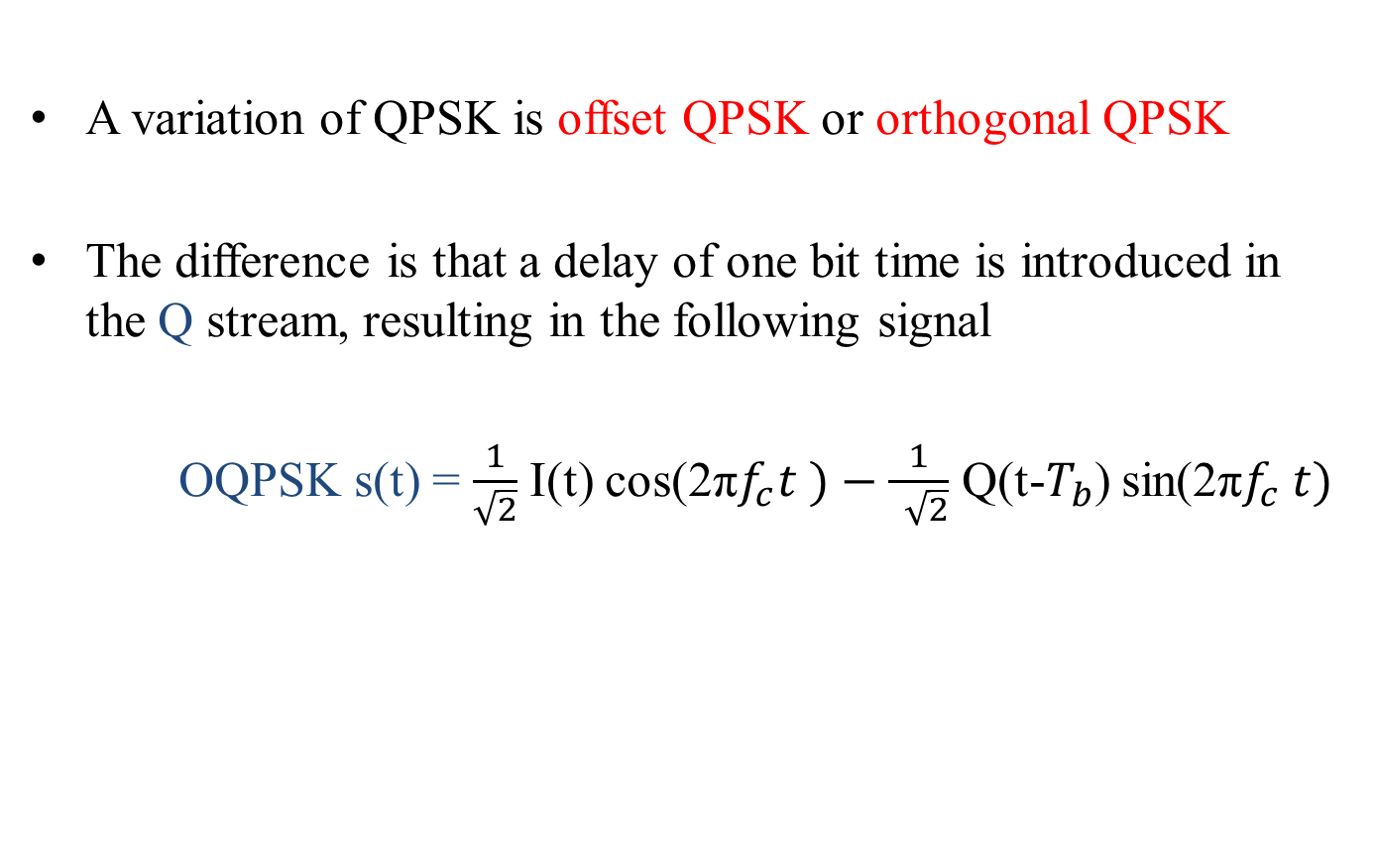
OQPSK Modulators
A variation of QPSK is offset QPSK or orthogonal QPSK
The difference is that a delay of one bit time is introduced in the Q stream, resulting in the following signal
OQPSK s(t) = $\frac{1}{\sqrt{2}}$ I(t) cos(2π$f_{c}t )−\frac{1}{ \sqrt{2}}$ Q(t-$T_{b}$) sin(2π$f_{c} t)$

Slide 106
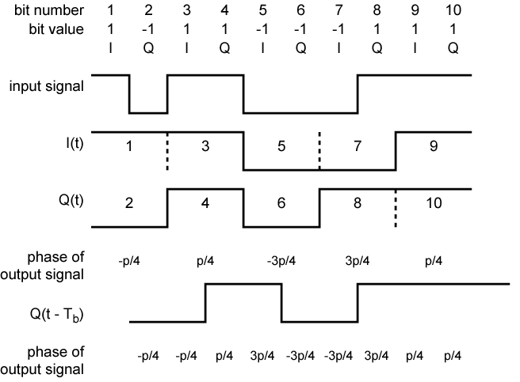
Examples of QPSF and OQPSK Waveforms

Slide 107
QPSK and OQPSK
In OQPSK,only one of the two bits in the pair can change at a time and thus the phase change in the combined signal never exceeds 90°(π/2).
Advantages of OQPSK over QPSK
Physical limitations on phase modulators make large phase shifts at high transition rates difficult to perform.
OQPSK also provides superior performance when the transmission channel (including transmitter and receiver) has significant non-linear components.
The effect of non- linearities is a spreading of signal bandwidth ,which may result in adjacent channel interference.
It is easier to control this spreading if the phase changes are smaller ,hence the advantage of OQPSK over QPSK

Slide 108
Multilevel PSK
The use of multilevel can be extended beyond taking bits two at a time
It is possible to transmit three bits at a time using eight different phase angles.
Each angle can have more than one amplitude also.
A standard 9600bps modem uses 12 phase angles ,four of which have two amplitude values ,for a total of 16 different signal elements.

Slide 109
Performance of Digital to Analog Modulation Schemes
Bandwidth of modulated signal depends on factors such as Filtering technique used to create bandpass signal
ASK and PSK bandwidth directly related to bit rate
Transmission bandwidth B_{T} for ASK and PSK is
R is data rate
r is related to filtering technique; 0< r <1
Thus the bandwidth is directly related to bandwidth.
Transmission bandwidth B_{T} for FSK is
where

Slide 110
Performance of Digital to Analog Modulation Schemes
With multilevel PSK(MPSK), bandwidth can improve significantly
Where L is the number of bits encoded per signal element.
With multilevel FSK(MFSK) we have

Slide 111

Bandwidth Efficiency
Bandwidth efficiency is the ratio of data rate to transmission bandwidth(R/$B_{t}$)
 | r=0 | r=0.5 | r=1
ASK | 1.0 | 0.67 | 0.5
FSK | 0.5 | 0.33 | 0.25
PSK | 1.0 | 0.67 | 0.5
MPSK,M=4, L=2 | 2.0 | 1.33 | 1.0
M=8, L=3 | 3.0 | 2.00 | 1.5
M=16, L=4 | 4.0 | 2.67 | 2.0
M=32, L=5 | 5.0 | 3.33 | 2.5

Slide 112
Quadrature Amplitude Modulation(QAM)
Quadrature Amplitude Modulation(QAM) is a popular analog signaling technique used on asymmetric digital subscriber line (ADSL) and some wireless standards
Combination of ASK and PSK
Logical extension of QPSK
Send two different signals simultaneously on same carrier frequency by
Using two copies of carrier frequency, one shifted 90°
Each carrier is ASK modulated
Two independent signals are simultaneously transmitted over the same medium
at the receiver, the two signals are demodulated and the results are combined to produce the original binary output

Slide 113
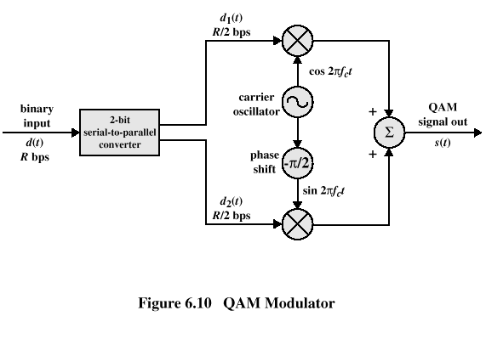
Quadrature Amplitude Modulation

Slide 114
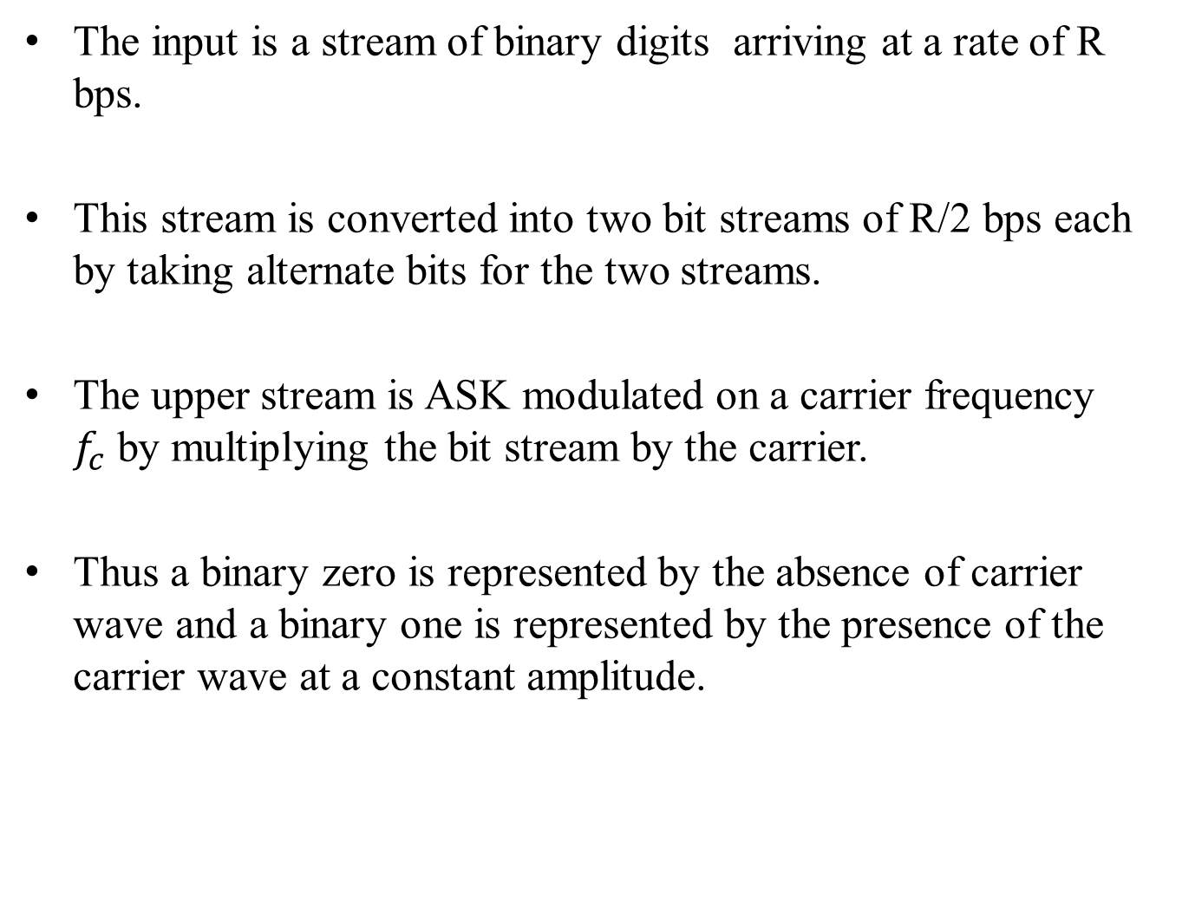
Quadrature Amplitude Modulation(QAM)
The input is a stream of binary digits arriving at a rate of R bps.
This stream is converted into two bit streams of R/2 bps each by taking alternate bits for the two streams.
The upper stream is ASK modulated on a carrier frequency $f_{c}$by multiplying the bit stream by the carrier.
Thus a binary zero is represented by the absence of carrier wave and a binary one is represented by the presence of the carrier wave at a constant amplitude.

Slide 115
Quadrature Amplitude Modulation(QAM)
This same carrier wave is shifted by 90° and used for ASK modulation of the lower binary stream.
The two modulated signals are then added together and transmitted.
The transmitted signal can be expressed as:

Slide 116
QAM Levels
If two- level ASK then,
Each of two streams can be in one of two states
Combined stream can be in one of 4=2*2 states.
This is essentially QPSK
Four level ASK (i.e four different amplitude levels)
Combined stream in one of 16 states
64 and 256 state systems have been implemented
The greater number of states ,the improved data rate for given bandwidth
But Increases potential error rate due to noise and attenuation.

Slide 117

Analog Data to Analog Signal
Modulation is defined as the process of combining an input symbol m(t) and a carrier frequency $f_{c}$ to produce a signal s(t) whose bandwidth is centered on $f_{c}$.

Slide 118
Reasons for Analog Modulation
Modulation of digital signals
When only analog transmission facilities are available, digital to analog conversion required
Modulation of analog signals
A higher frequency may be needed for effective transmission
For unguided transmission,it is virtually impossible to transmit baseband signals;the required antennas would be many kilometers in diameter.
Modulation permits frequency division multiplexing(FDM)

Slide 119
Basic Encoding Techniques
Analog data to analog signal
Amplitude modulation (AM)
Angle modulation
Frequency modulation (FM)
Phase modulation (PM)

Slide 120
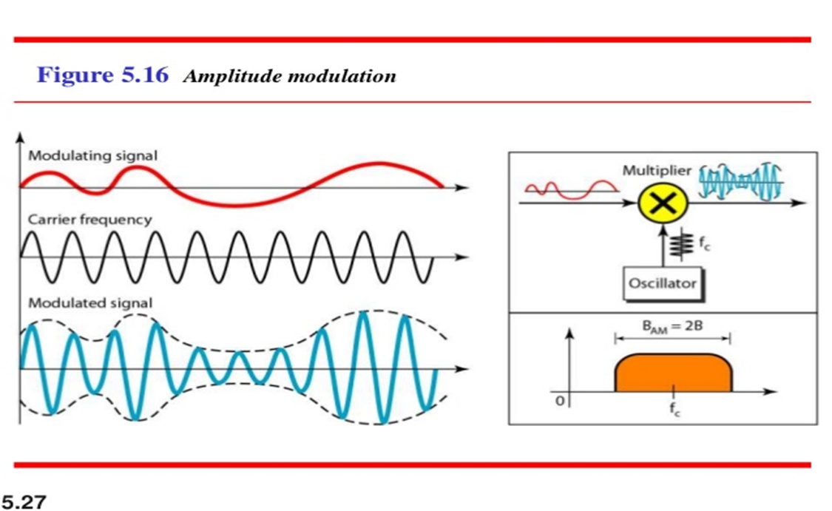
Amplitude Modulation
Amplitude Modulation
Amplitude modulation (AM)is the simplest form of modulation and is depicted in fig. below.

Slide 121
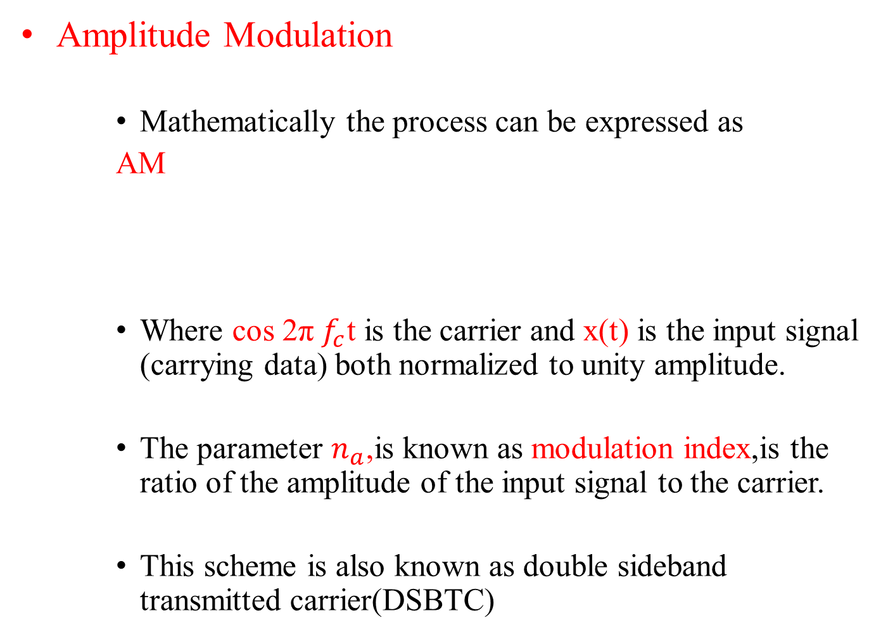
Amplitude Modulation
Amplitude Modulation
Mathematically the process can be expressed as
AM
Where cos 2π $f_{c}$t is the carrier and x(t) is the input signal (carrying data) both normalized to unity amplitude.
The parameter $n_{a}$,is known as modulation index,is the ratio of the amplitude of the input signal to the carrier.
This scheme is also known as double sideband transmitted carrier(DSBTC)

Slide 122
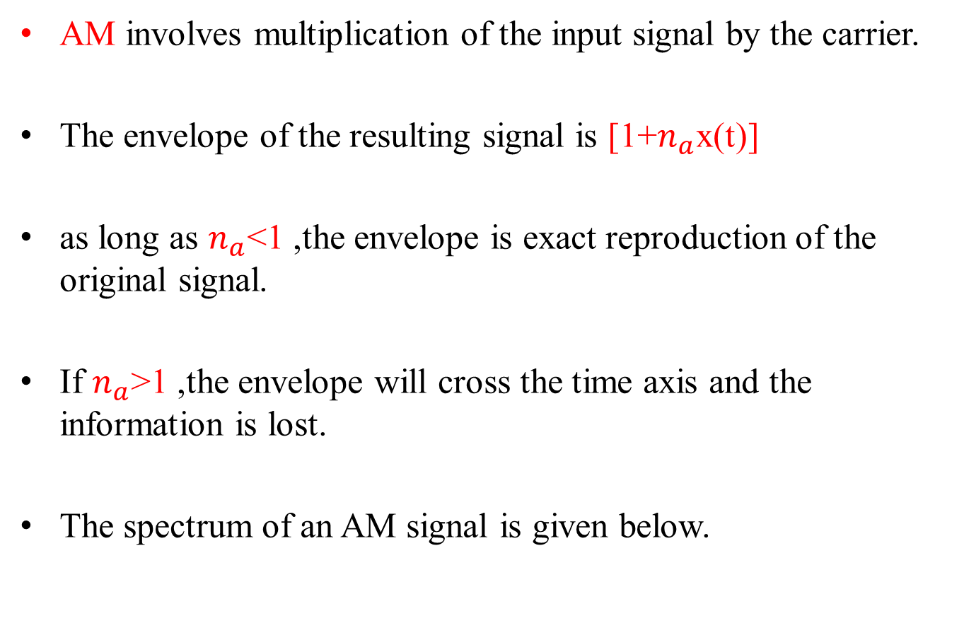
Amplitude Modulation
AM involves multiplication of the input signal by the carrier.
The envelope of the resulting signal is [1+$n_{a}$x(t)]
as long as $n_{a}$<1 ,the envelope is exact reproduction of the original signal.
If $n_{a}$>1 ,the envelope will cross the time axis and the information is lost.
The spectrum of an AM signal is given below.

Slide 123
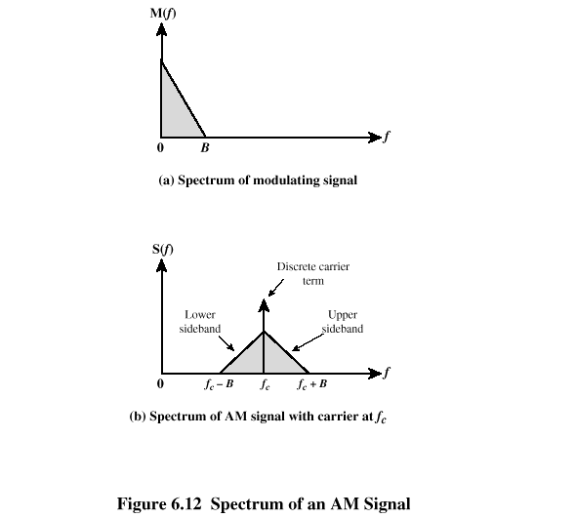
Spectrum of AM signal

Slide 124

Spectrum of AM signal
The spectrum consists of the original carrier plus the spectrum of the input signal translated to$f_{c}$
The portion of the spectrum for | f | > | $f_{c}$| is the upper side band.
The portion of the spectrum for | f | < | $f_{c}$| is the lower side band
Both the upper and lower sidebands are replicas of the original spectrum M(f),with lower sideband being frequency reversed.

Slide 125

Power of AM signal
An important relationship is ,
Transmitted power,$P_{t}$= $P_{c}$(1+$\frac{{na}_{}^{2}}{2})$
$P_{t}$→total transmitted power in s(t)
$P_{c}$→transmitted power in the carrier
$n_{a}$should be large as possible so that most of the signal power is used to carry information.(but it must remain 1)

Slide 126

Single-Side Band(SSB)
A Variant of Amplitude Modulation(AM).
In AM,s(t) contains unnecessary components ,because each of the side bands contains the complete spectrum of m(t).
SSB takes advantage of this fact by sending only one of the sidebands, eliminating the other sideband and the carrier.
The principal advantages of this approach are as follows:
Only half the bandwidth is required ,that is ,$B_{T}$=Where B is the bandwidth of the original signal. For DSBTC, $B_{T}$=2B
Less power is required because no power is used to transmit the carrier on the other side

Slide 127
Double Side Band Suppressed Carrier(DSBSC)
Another variant is double sideband suppressed carrier (DSBSC) ,which filters out the carrier frequency and sends both side bands .
This saves some power but uses as much bandwidth as DSBTC
The disadvantage of suppressing the carrier is that the carrier can be used for synchronization purposes.
A compromise approach is Vestigial sideband(VSB),which uses one sideband and a reduced-power carrier.

Slide 128


Slide 129
Angle Modulation
Frequency modulation(FM) and Phase modulation(PM).
The modulated signal is expressed as:
Angle modulation

Slide 130
Angle Modulation
Phase modulation
Phase is proportional to modulating signal
PM
n_{p} = phase modulation index
Frequency modulation
Derivative of the phase is proportional to modulating signal
FM
n_{f} = frequency modulation index

Slide 131
Angle Modulation
Compared to AM, FM and PM result in a signal whose bandwidth:
is also centered at f_{c}
but has a magnitude that is much different
Angle modulation includes cos(∅ (t)) which produces a wide range of frequencies
Thus, FM and PM require greater bandwidth than AM

Slide 132
Angle Modulation
Carson’s rule
where
The formula for FM becomes

